Slide 1
Welcome to the Vollara Lifeline Freedom Call
You are invited to join our mission
Protect every indoor Environment in North America with ActivePure
Build superior health from the inside out and the outside in

Slide 2
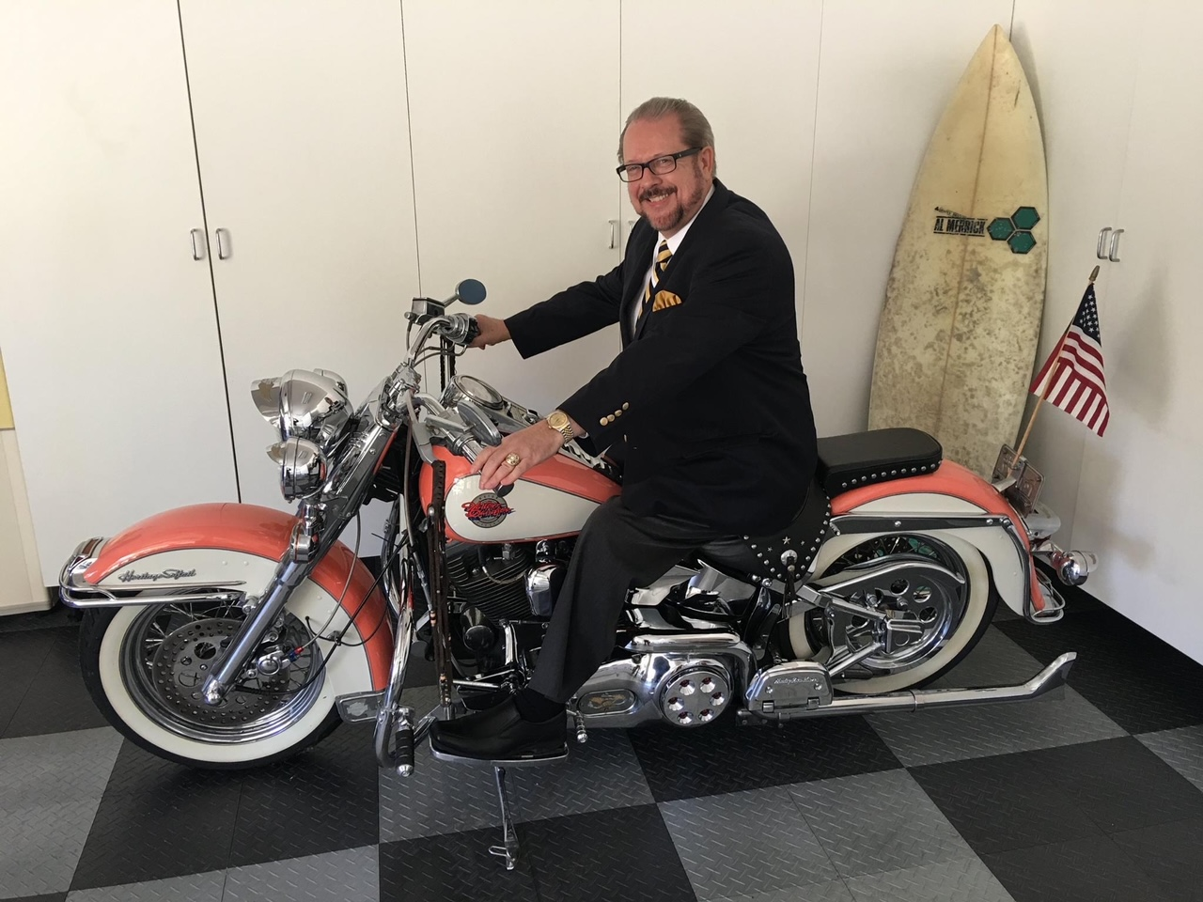
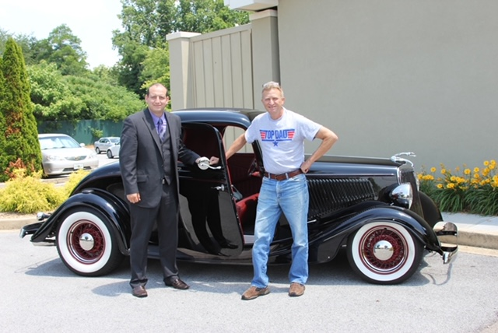
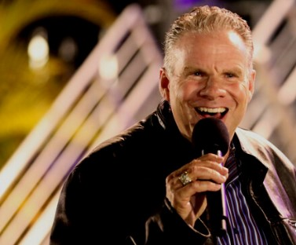
Bill Coyle Executive VP
Michael Jackson
National Field Leader and
Robia Turner National Trainer
Your National Support Team
Dr. Omar Hamada
Science and Medical Advisor
Dr. Eric Gonyon

Slide 3
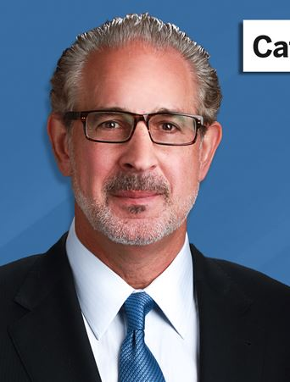
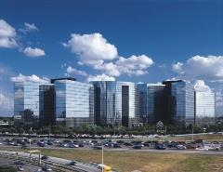
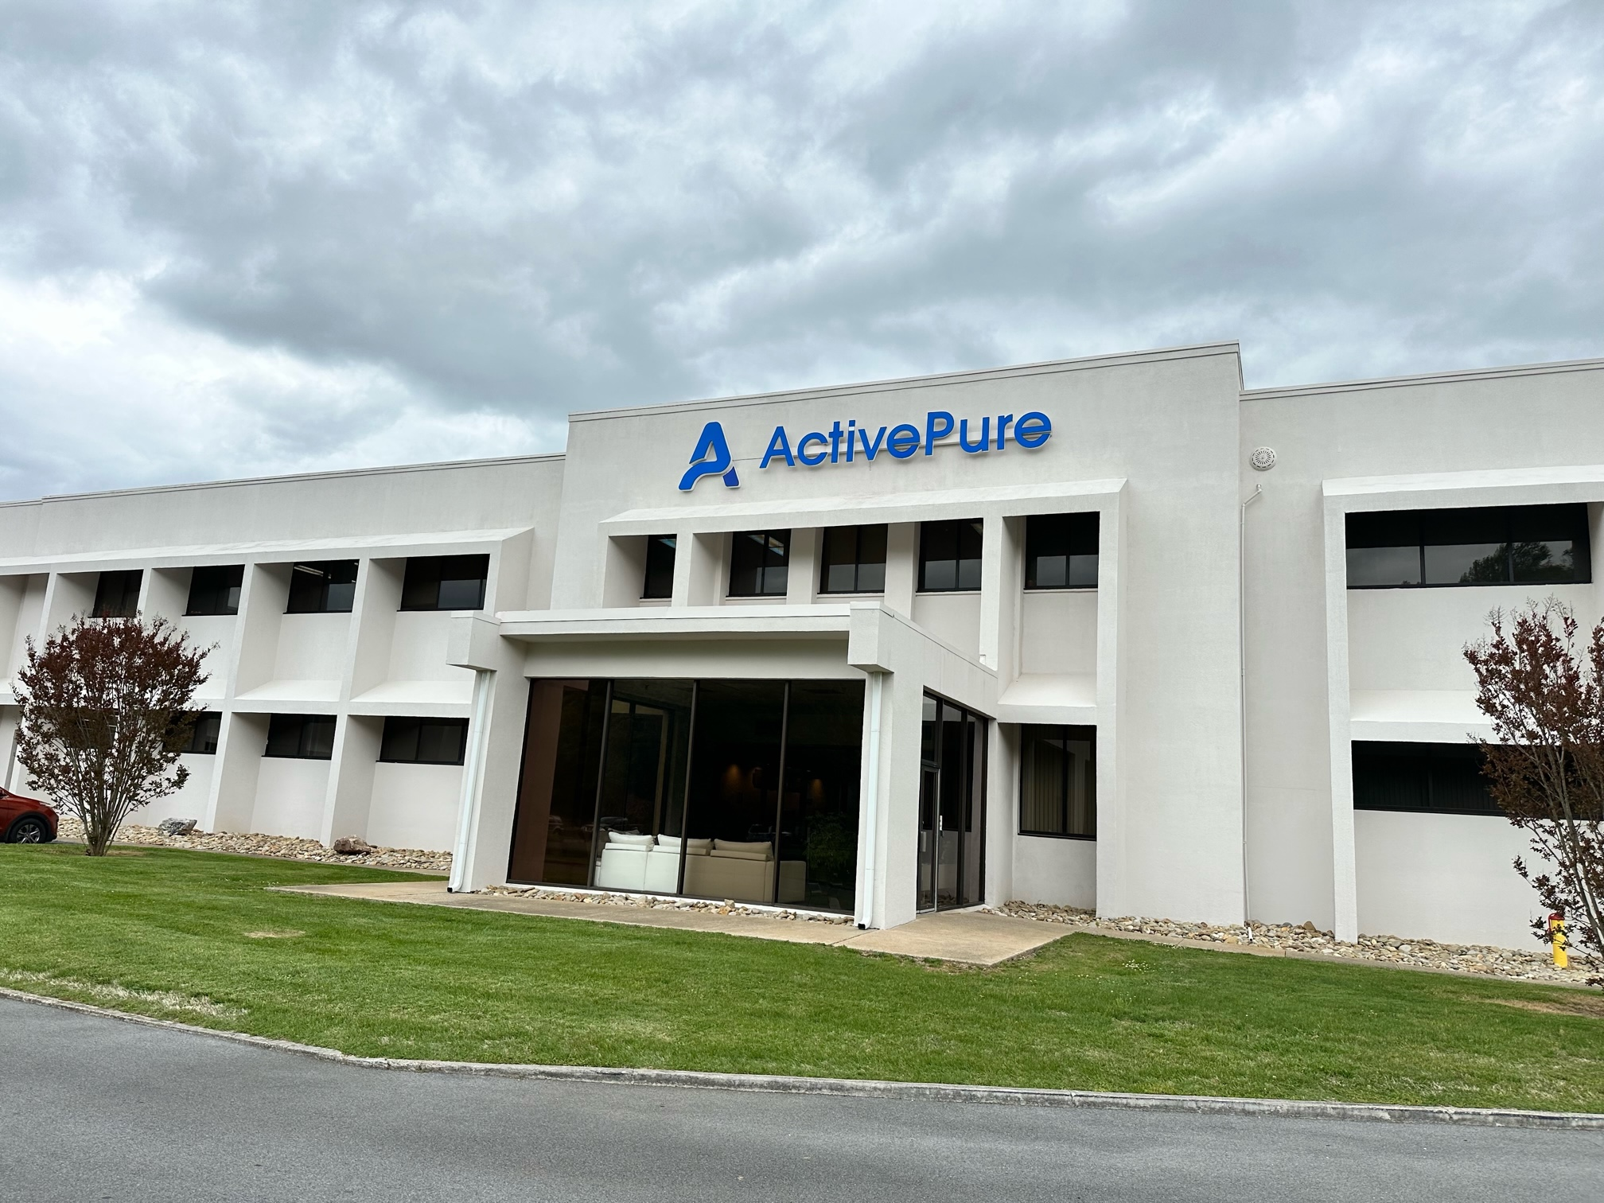
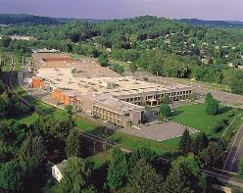
Welcome to Vollara America’s Company A Major US Corporation helping to reopen America and The World
Joe Urso – Chairman and CEO
ActivePure Technologies, LLC
World Headquarters: Dallas, Texas
500,000 sq. ft. Manufacturing Plant: Bristol, Virginia
Corporate World Headquarters
Dallas, Texas
Manufacturing Facility
Bristol, Virginia

Slide 4
September 1st news
newsTexas school district shuts down, citing surge in COVID-19
Kentucky closes schools
It seems like everyone has Covid-19. Here’s why this wave is probably worse than official data suggests CNN
Calls in last 24 hours for over 15,000 cell replacements

Slide 5
The EPA states Indoor Air is up to 5 X worse
1970’s sealed our buildings with deadly precision – Wall Street Journal
Nearly 100% of homes have mold and myco toxins – Infection control today
Mold spores' triple asthma rate in last 20 years
Formaldehyde exceeding .01 ppm watery eyes, nose, skin irritation found in pressed wood, foam insulation, wallpaper, cosmetics and personal care
And today there are new challenges in the form of viruses
WHO Chief Warns future pathogens will be even deadlier than Covid 19 – When the next pandemic comes and it will, we have to be ready and can’t kick the can down the road – WHO Chief

Slide 8
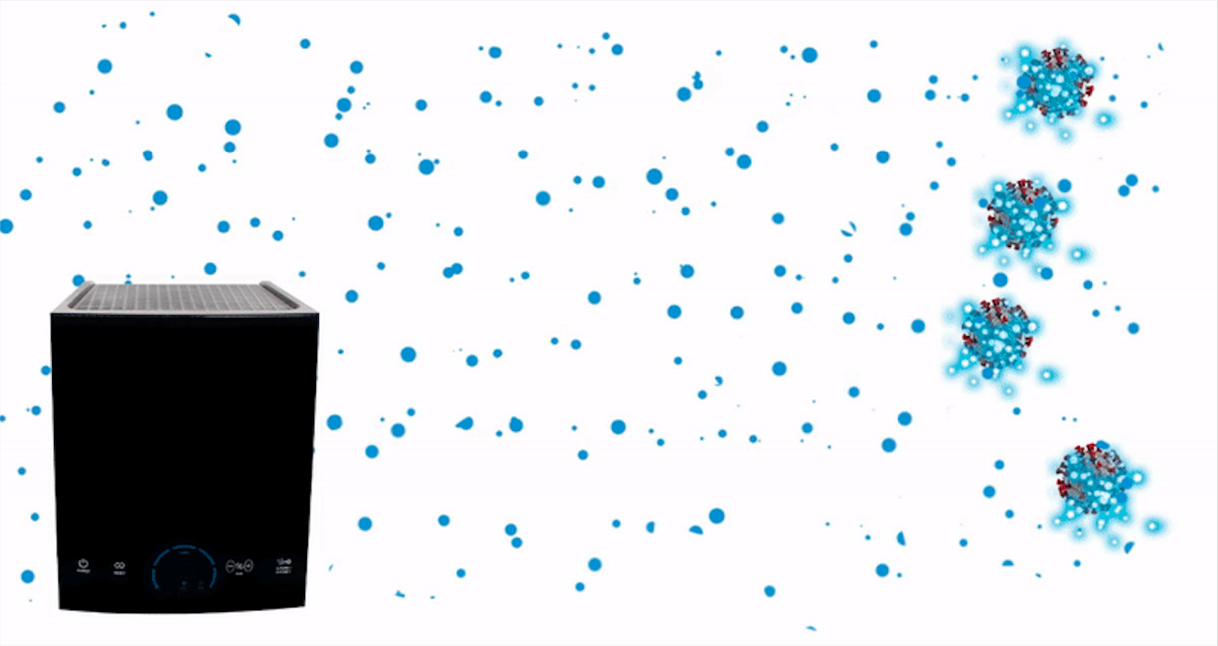
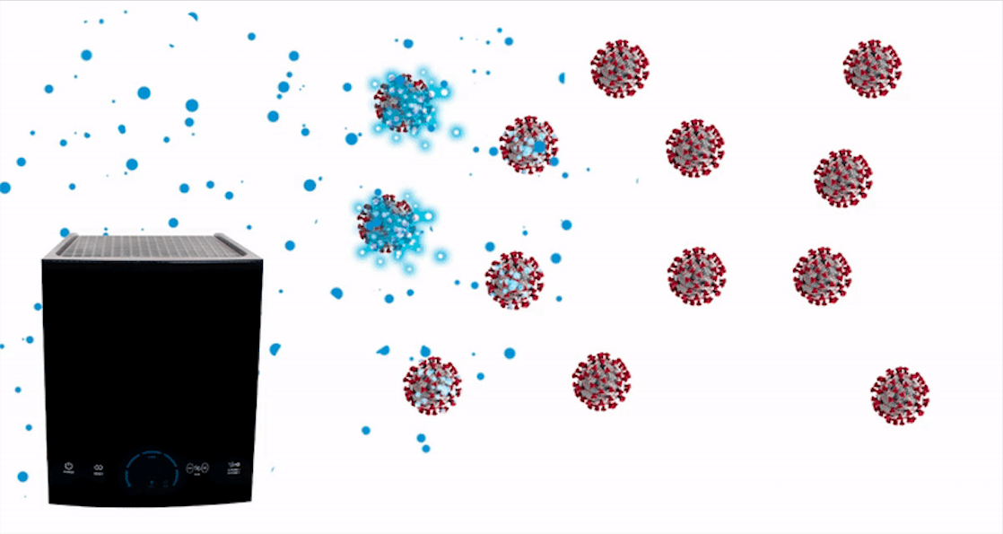
HOW ACTIVEPURE WORKS
1) ActivePure pulls free oxygen and water molecules in the air through its patented honeycomb matrix.
2) The honeycomb cells create and release disinfecting air molecules at ultra-high speeds (1200 feet per second) that latch onto and eliminate 99.9999% of air and surface hazards within minutes of exposure:
DNA and RNA viruses
SARS-CoV-2 (COVID-19)
Swine Flu (H1N1)
Avian Bird Flu (H5N8)
Hepatitis A (HAV)
MS2 bacteriophage
3) Multi-point positive and negative Ionization (NOT BIPOLAR) then make all air particulates drop up to 200 times faster than gravity and clear the air we breathe of hazards immediately.

Slide 9
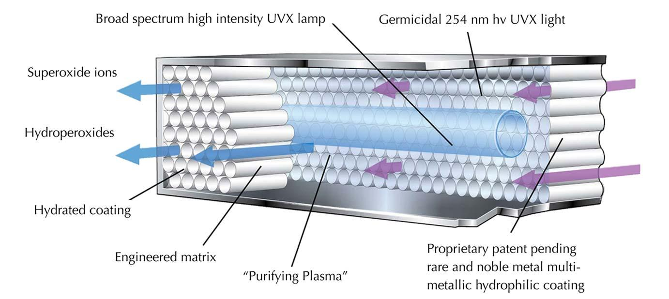
THE PATENTED ACTIVEPURE CELL
Through UV light waves and a catalytic process, the patented honeycomb cells produce super oxide ions and hydro peroxides that destroy contaminants in the air and on surfaces.

Slide 10
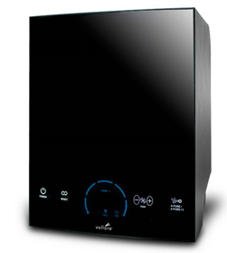
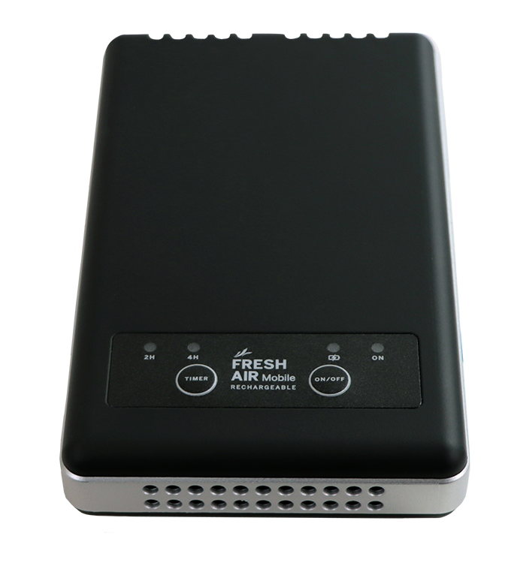
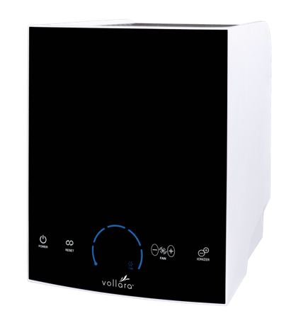
A perfect solution for every indoor environment
Rechargeable Mobile
Vollara Air and Surface Pros & Mobile with ActivePure
Covers from 50 to 3500 square feet
Removes particles from air 200 times faster
In 60 seconds, 99.96% reduction of SARS CoV 2
Effective for Mold, Bacteria, Viruses and odors
Air & Surface Pro
Air & surface Pro XL

Slide 11
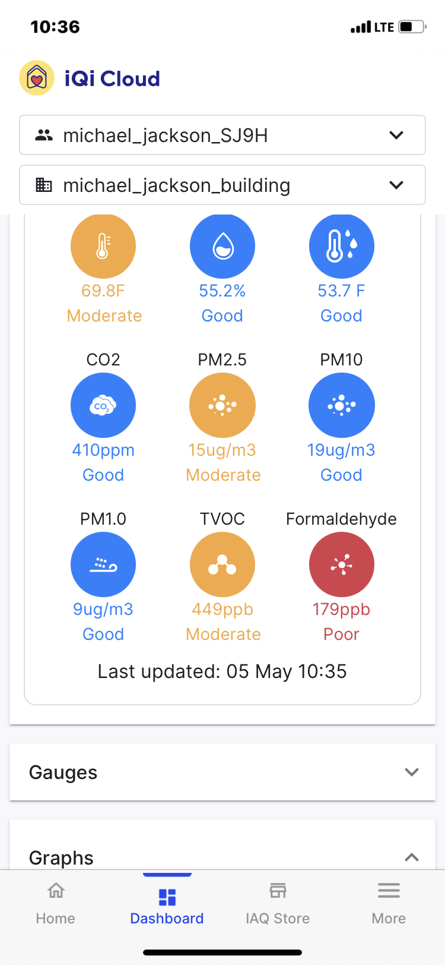
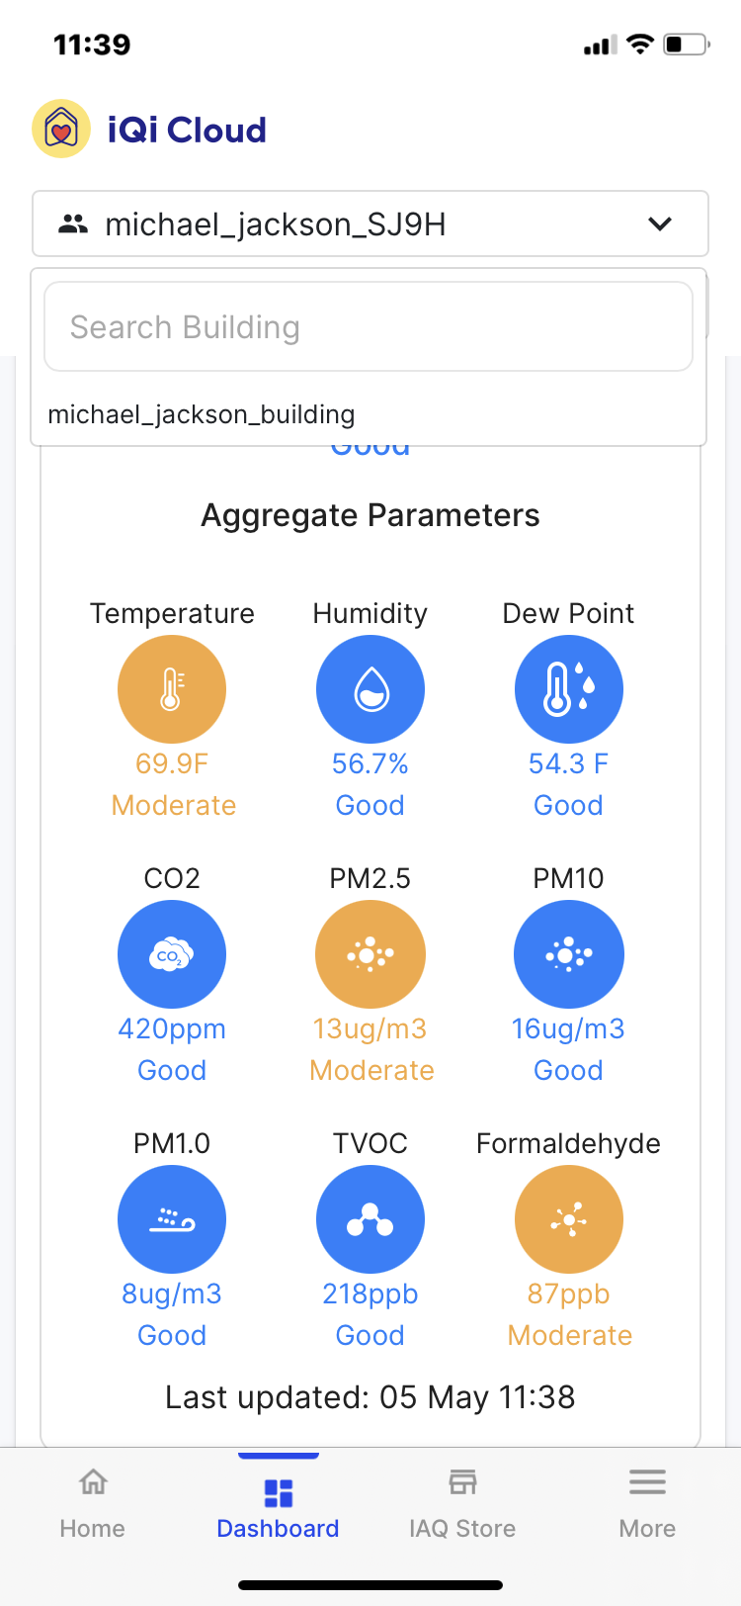
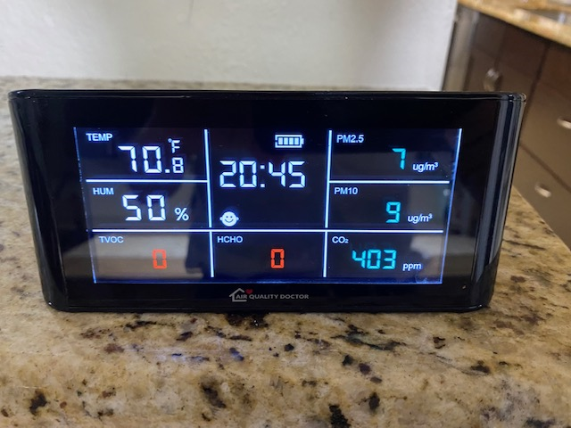
Real world results actual in home test

Slide 12
Dozens of studies prove ActivePure stands alone!

Slide 15
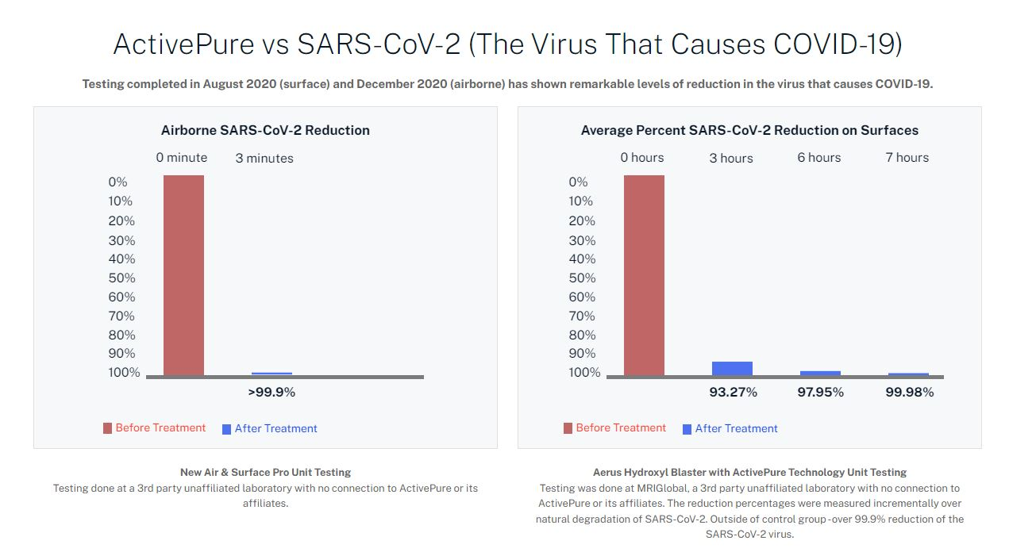
FDA Cleared Studies Show ActivePure Inactivates SARS CoV2
To 99.96% in 60 seconds
0 minute
1 minute

Slide 16
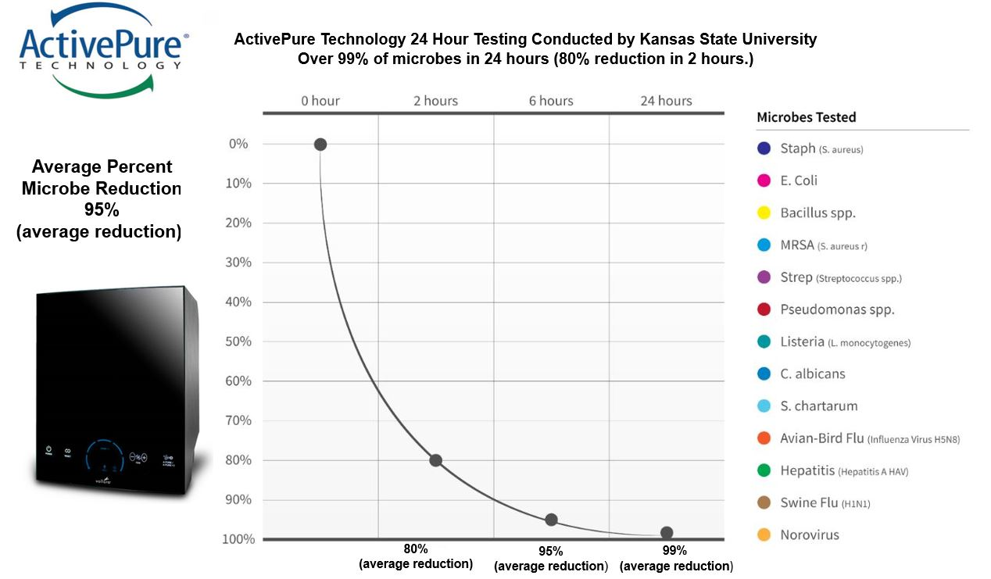

Slide 17
Where ActivePure is Used…
Used in treating millions of Homes
Businesses
26 Pro Baseball Teams
NASA Space Station
Ground Zero Museum
Liberty Bell Museum
Hospitals – Care Without Fear of Secondary Infections
Doctors & Dental Offices
Restaurants
Nursing Homes
Health Clubs
Schools
Cars / Buses / Uber
Corporate Offices
City, County, State, Federal Incarceration Facilities
Notes:
ActivePure makes environments healthy and safe

Slide 18
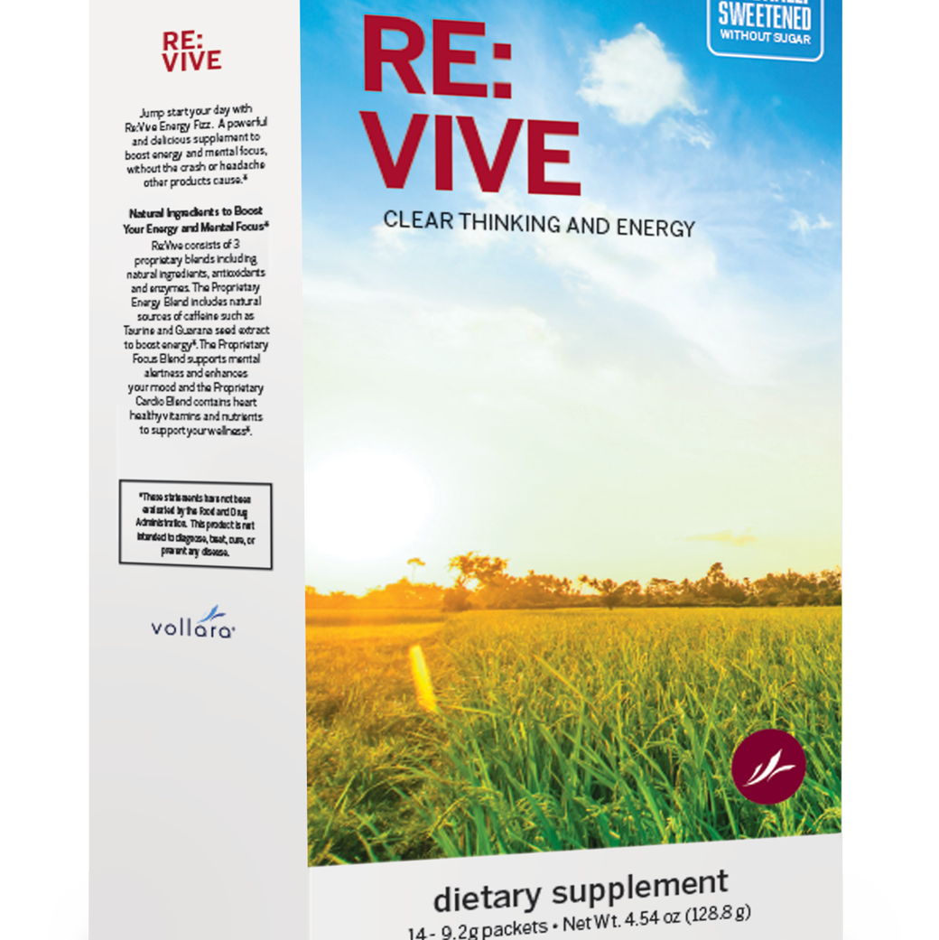
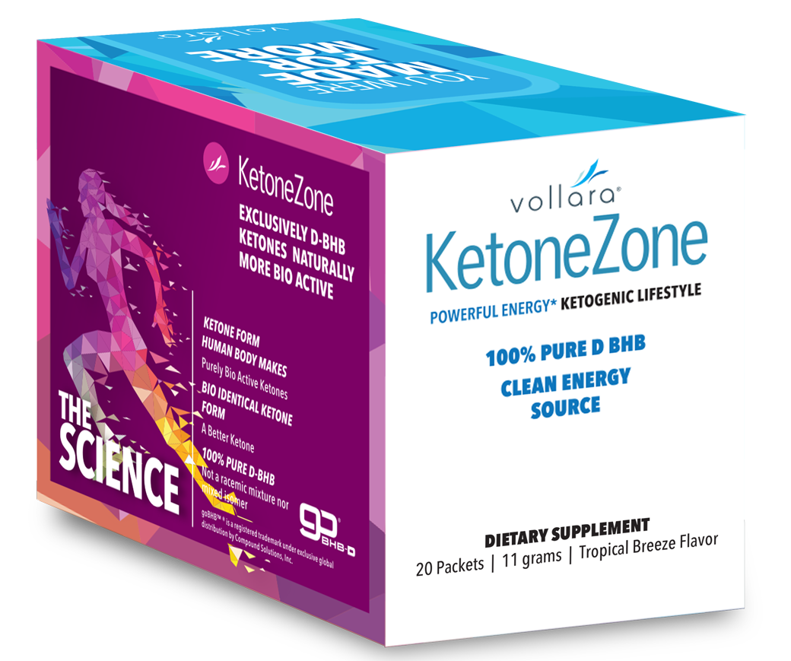
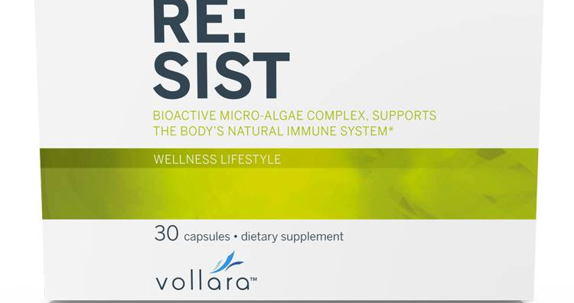
Introducing The Gateway Giveaway 4 Free
First of its kind in history
Free 1st month supply of one product
Free shipping
Sales Tax paid by Company
$10 customer acquisition bonus for each one
Giveaway 50 by end of year and receive 1oz
Gold Bar!
The Ultimate client acquisition program

Slide 19
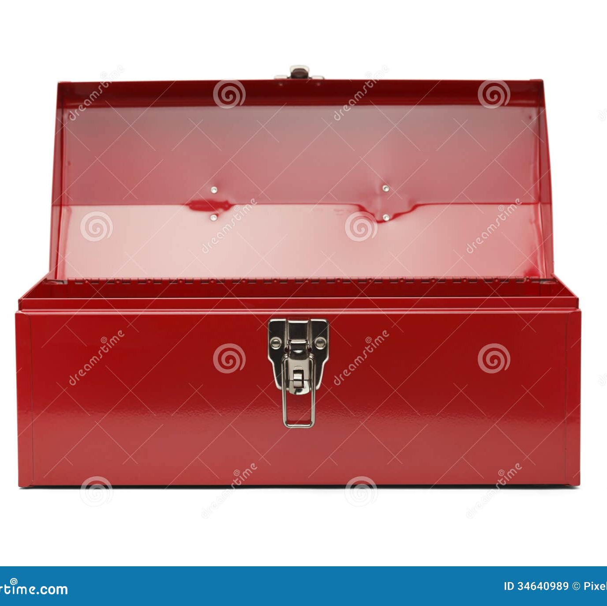
Each business builder has a support Toolbox

Slide 20
How are we compensated – Let me count the ways
Real Estate – You get paid commissions from sale – 2%
Mortgage banker – 1.5%
JOB – Pay check on Friday
Home Maker – Labor of love
Most careers pay one way
Baker
At Vollara count the ways

Slide 21
Vollara Compensation 15 ways to earn Profit from Effort! Multiple Streams of Income
Retail Sales Profit
SSS Sign Up Bonus Pay Out $10 (NEW Pilot Program)
Team Qualified Volume Bonus Payout
Fast Start Bonus Payout
Sponsor Fast Start Bonus (SFSFV)
Promotion Bonuses – Paid Out In Product Credit
Executive Car Bonus Payout
Executive Generational Bonuses
Executive Fast Start Bonus Boost
Monthly Executive Gold Bullion Bar Drawing (NEW)
Executive Bonas Pool Payout (NEW)
Nutritional Loyalty Rewards – Quarterly Payout in Product Credits
Various & Many Sponsor with Pack Bonus Payouts
Periodic Contests, Incentives, & Rewards
Annual VIP Trip Incentive
The question you must ask yourself: How many of these do I earn each month?
Better yet. How many did you not even realize we have available!

Slide 22
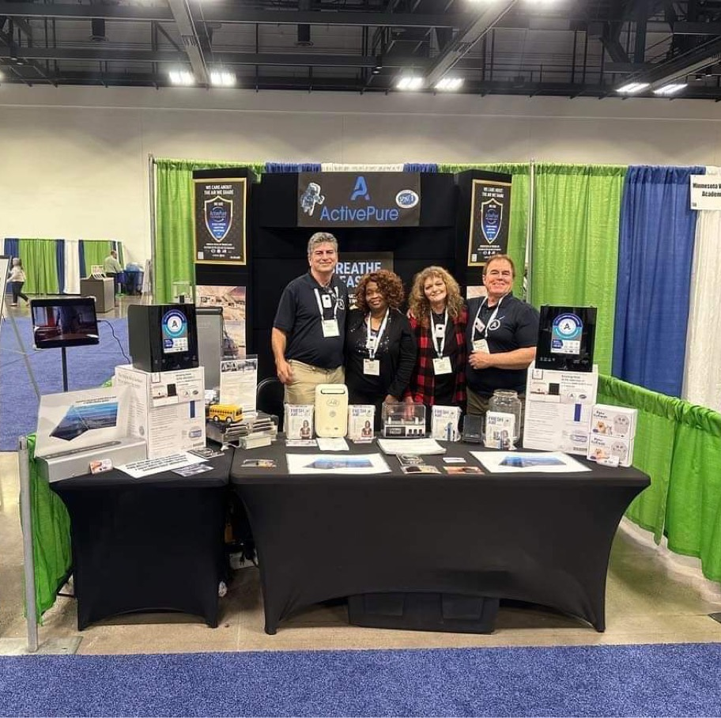
Retailing is fun and Profitable
You can Retail to warm market
Shows
Health Club
Work
Family
Friends
Essential Living Solution Showcases
Personal Example
3 day trial sale – Puppy Dog Sale

Slide 23
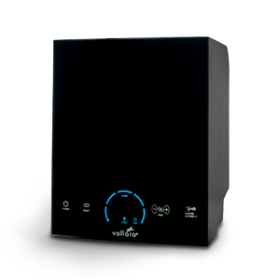
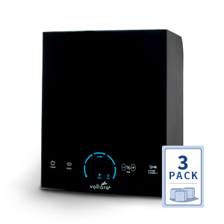
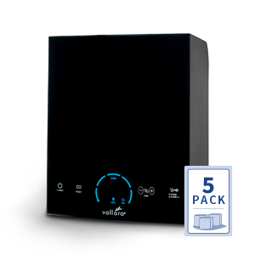
Profit is better than wages – Jim Rohn
Vollara Air & Surface Pro Pricing & Aerus Pure & Clean+
MSRP - $799.99
Vollara ASP
9940062 | $399.99 | 200 PV
Vollara ASP+ branded Aerus Pure & Clean+*
00747 | $399.99 | 200 PV
MSRP - $2,399.97
Vollara ASP 3 Pack
9981291 | $1,099.97 | 500 PV
Vollara ASP+ 3 Pack branded Aerus Pure & Clean+*
9981410 | $1,099.97 | 500 PV
Sponsoring Pack Bonus $50.00
$366.65 each in 3 unit Success Pack
MSRP - $3,999.95
Vollara ASP 5 Pack
9981295 | $1,749.95 | 750 PV
Vollara ASP+ 5 Pack branded Aerus Pure & Clean+*
9981411 | $1,749.95 | 750 PV
Sponsoring Pack Bonus $100.00
$349.99 in 5 unit Builder Success Pack
Earn up to $450.00 on each Retail Sale
1 sale weekly = $23,400 annual!

Slide 24
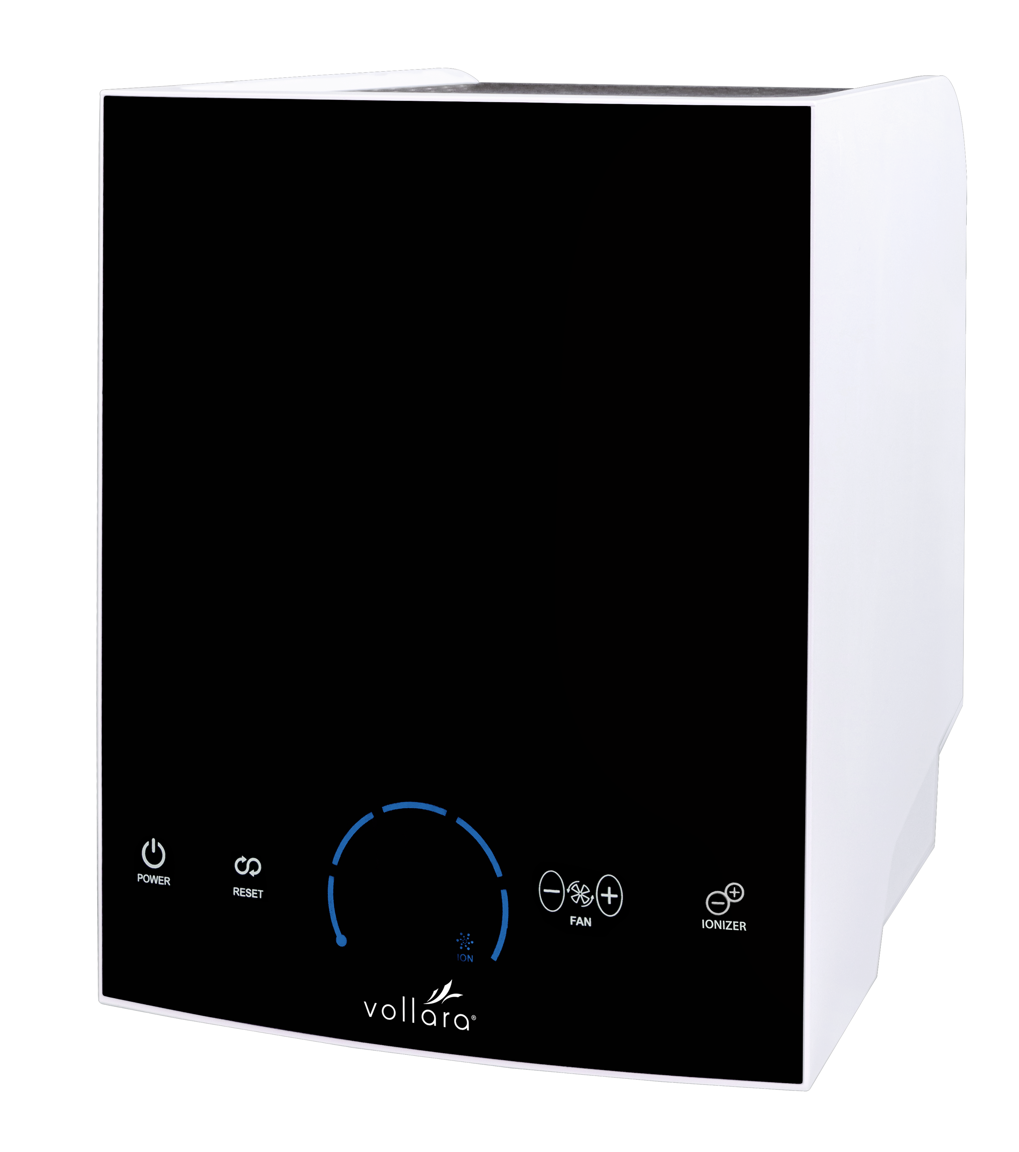
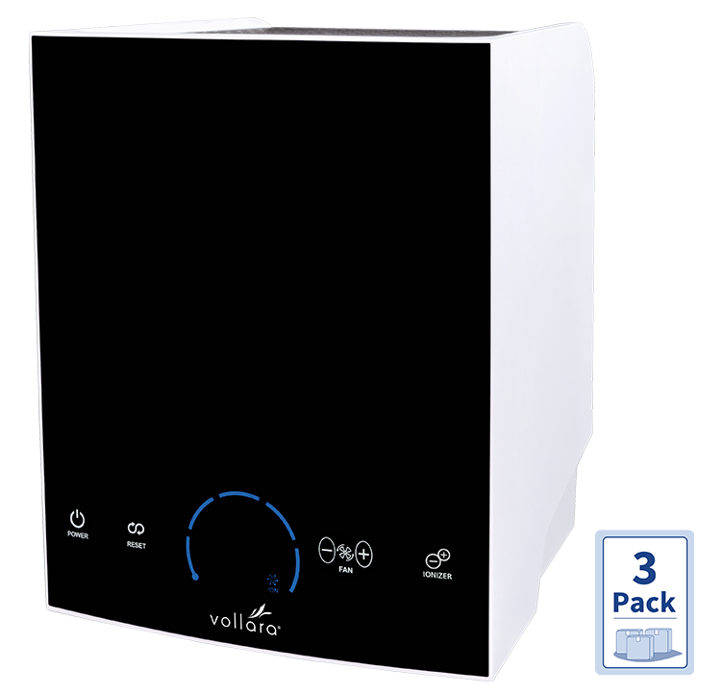
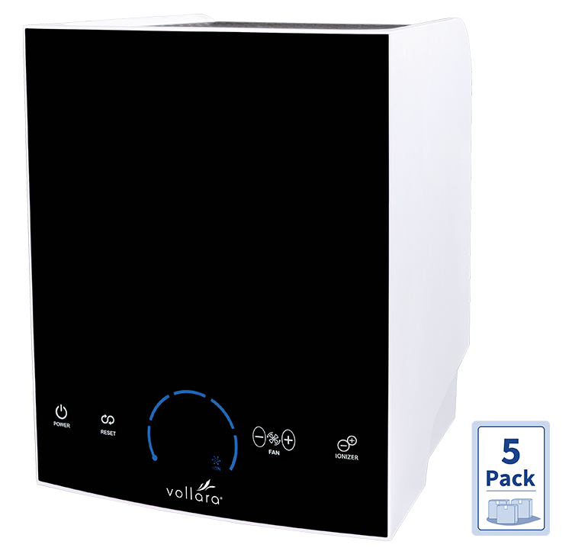
Vollara Air & Surface Pro XL* Pricing (exclusive for Vollara)
MSRP -$1,499.99
Vollara ASP XL
00772 | $599.99 | 350 PV
New MSRP -$4,499.97
Vollara ASP XL 3 Pack
9981446 | $1,734.97 | 1000 PV
Sponsoring Pack Bonus $150.00
$570.32 in 3 unit Success Pack
New MSRP -$7,499.95
Vollara ASP XL 5 Pack
9981448 | $2,749.95 | 1500 PV
Sponsoring Pack Bonus $200.00
$549.99 in 5 unit Builder Success Pack
Our most profitable home and office unit – up to $950.00 profit per unit
1 sale per week = nearly $50,000 annual! 1 per month = $11,400 annual
*CARB Certified

Slide 25
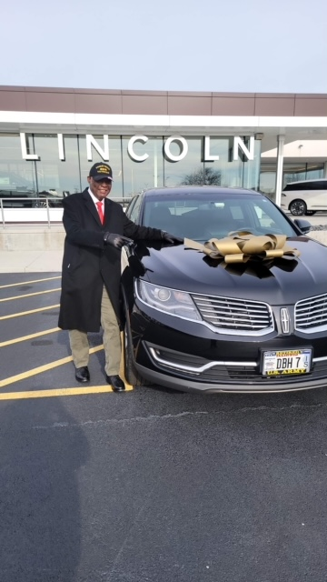
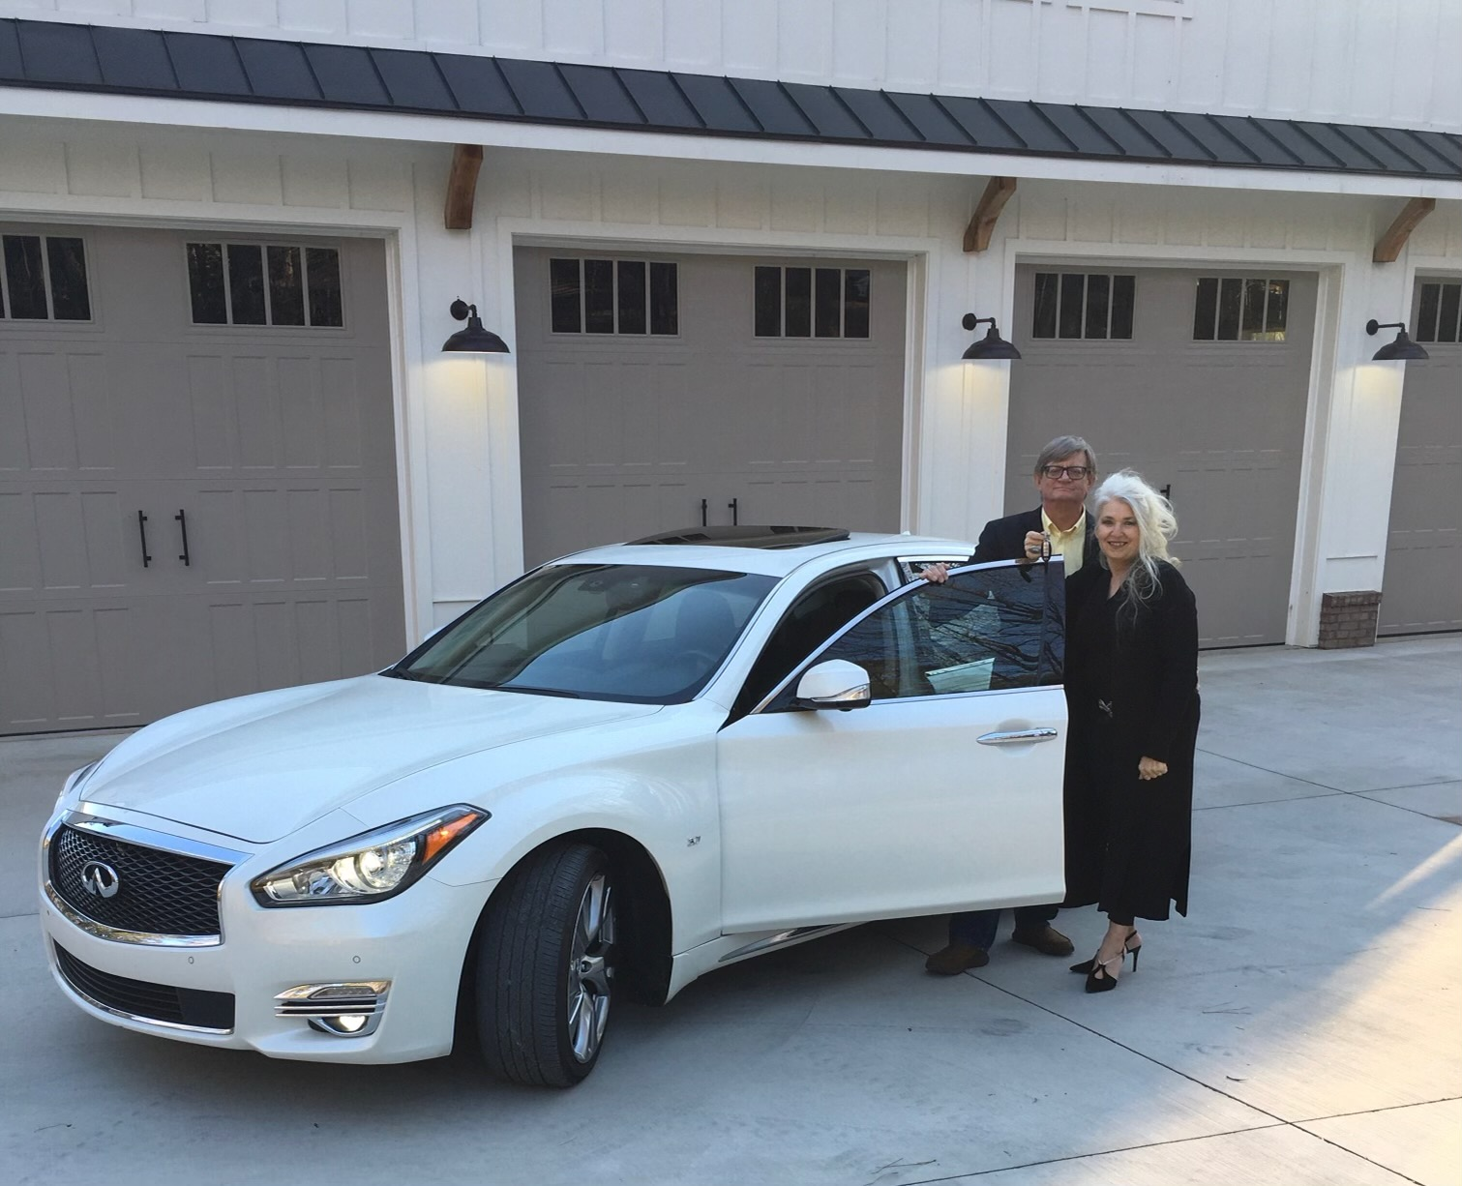
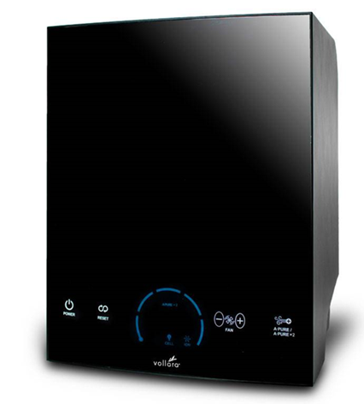
You can build a Wholesale Team
Beginner Gold Executive
Conducting business at same price you pay
Customers, Retailers, Bronze & Silver Executives
Example: Generating 10,000 Team Volume /Month (under 30 ASP XL or 7 ASP XL packs)
You earn up to 35% (average 20%) = $2000 /mo. = $ 24,000 /year
You earn $600 Executive Car Bonus /mo. = 7,200 /year
One Personal Retail Sale Monthly = 11,400 /year
$42,600 Annual PT

Slide 26
A more mature Gold Wholesale Team
Customers, Retailers, Bronze & Silver Executives
Example: Generating 25,000 Team Volume /Month
14 - 5 packs on entire personal team
25 – 3 packs on entire personal team
250 on Subscribe and Save on entire personal team
You earn up to 35% (average 20%) = $5,000 /mo. = $ 60,000 /year
You earn $600 Executive Car Bonus /mo. = 7,200 /year
You earn a VIP Trip = 10,000 /year
You earn $1,000 Executive VIP Bonus Boost /mo. = 12,000 /year
Earn up to $10,000 monthly by building big $120,000 annual
You earn Fast Start Bonuses = 15,000 /year
$104,200 /year

Slide 27
Five Year Plan
Build Multiple Business Centers Generating 25,000 Team Volume
Mike and Nata Helped 10 become GOLD Executives averaging over
25,000 Team Volume – Mike and Nata’s first generation business centers
Michael and Jennie Gonzalez - Oceanside Ca
Keith and Jan Jones - Minnesota
Robia Turner and Heather Jackson - Tennessee
New Jersey Tom
Taylor and Greg Gray Pa
Abe Silos South Carolina
Enrique Muniz Florida
Pastor Eric Gonyon Florida
Phil Johnson Wisconsin
Ryan Allaire Minnesota
Earn 15% x 25,000 x 8 = $37,500.00 per month
250,000 team volume (has reached 2,000,000 in one month) *maintain 12,000 team
Earn up to five levels deep

Slide 30
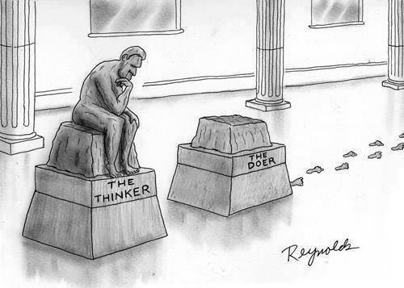

Slide 31
Introducing The Gateway Giveaway 4 Free
First of its kind in history
Free 1st month supply of one product
Free shipping
Sales Tax paid by Company
$10 customer acquisition bonus for each one
Giveaway 50 by end of year and receive 1oz
Gold Bar!
The Ultimate client acquisition program

Slide 32
Vollara Air & Surface Pro XL* Pricing (exclusive for Vollara)
MSRP -$1,499.99
Vollara ASP XL
00772 | $599.99 | 350 PV
New MSRP -$4,499.97
Vollara ASP XL 3 Pack
9981446 | $1,734.97 | 1000 PV
Sponsoring Pack Bonus $150.00
$570.32 in 3 unit Success Pack
New MSRP -$7,499.95
Vollara ASP XL 5 Pack
9981448 | $2,749.95 | 1500 PV
Sponsoring Pack Bonus $200.00
$549.99 in 5 unit Builder Success Pack
Our most profitable home and office unit – up to $950.00 profit per unit
1 sale per week = nearly $50,000 annual! 1 per month = $11,400 annual
*CARB Certified

Slide 33
Profit is better than wages – Jim Rohn
Vollara Air & Surface Pro Pricing & Aerus Pure & Clean+
MSRP - $799.99
Vollara ASP
9940062 | $399.99 | 200 PV
Vollara ASP+ branded Aerus Pure & Clean+*
00747 | $399.99 | 200 PV
MSRP - $2,399.97
Vollara ASP 3 Pack
9981291 | $1,099.97 | 500 PV
Vollara ASP+ 3 Pack branded Aerus Pure & Clean+*
9981410 | $1,099.97 | 500 PV
Sponsoring Pack Bonus $50.00
$366.65 each in 3 unit Success Pack
MSRP - $3,999.95
Vollara ASP 5 Pack
9981295 | $1,749.95 | 750 PV
Vollara ASP+ 5 Pack branded Aerus Pure & Clean+*
9981411 | $1,749.95 | 750 PV
Sponsoring Pack Bonus $100.00
$349.99 in 5 unit Builder Success Pack
Earn up to $450.00 on each Retail Sale
1 sale weekly = $23,400 annual!

Slide 34
www.myvollaratools.com to register for weekly training classes on Saturday Mornings

