Slide 1
Welcome to Vollara
Billionaire Mark Cuban’s Business Advice for Entrepreneurs
“If there’s ever a benefit from a pandemic, it’s that there will be people who have a new vision for the future. I call it America 2.0.”
“I think this is a phenomenal time to create new opportunities in business. I don’t think there’s a better time ever to start a company.”

Slide 2
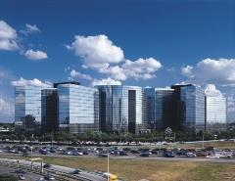
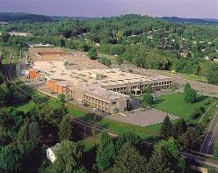
Vollara – Your Partner
Aerus Holdings: Over 90 years in Direct Sales Business
39th Largest Direct Selling Company in the World
Company World Headquarters: Dallas, Texas
500,000 sq. ft. Manufacturing Plant: Bristol, Virginia
Corporate World Headquarters
Dallas, Texas
Manufacturing Facility
Bristol, Virginia

Slide 3
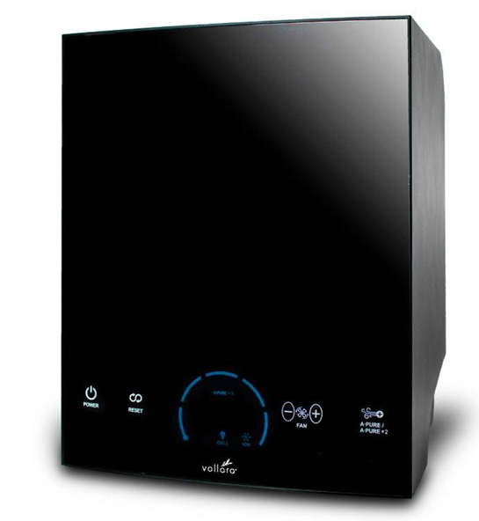
Battelle – Solving The World’s Most Pressing Problems
Battelle’s Mission: To translate scientific discovery and technology advances into societal benefit
A Battelle Scientific Report on the Top 10 Trends for a Healthy Home for 2018 and beyond…
Trend #1
Indoor Air Quality
Trend #8
Management of Dust Mites
Trend #10
Germ Protection on Surfaces

Slide 4
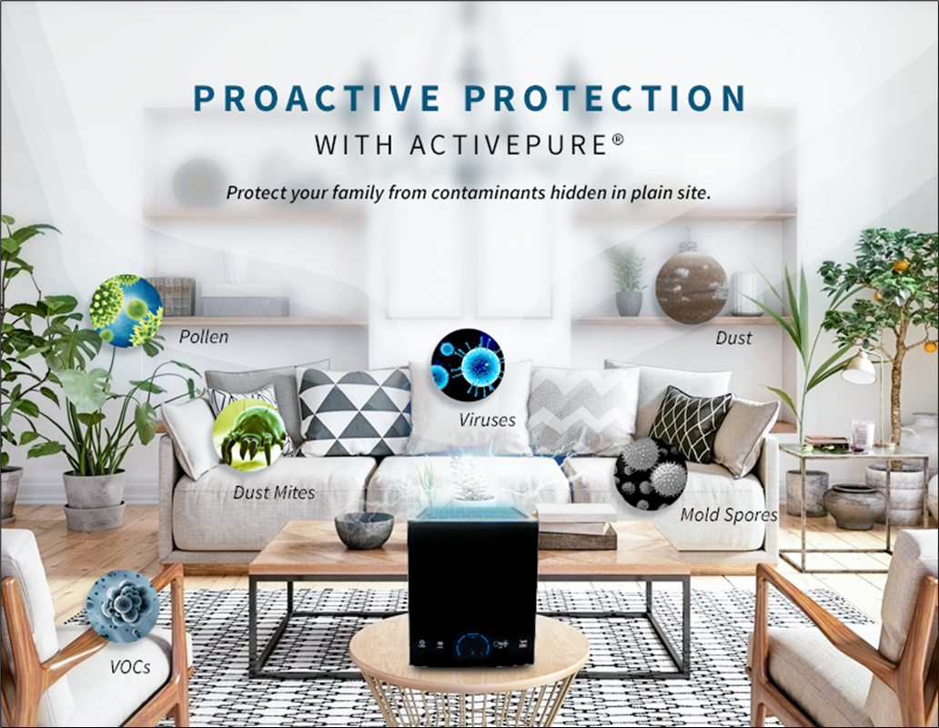
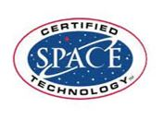

Slide 6
One of only 75 technologies inducted into the Space Technology HALL OF FAME in the past 30 years

Slide 7
Safe, Effective, Proven, Certified
Traditional ‘passive’ technologies, such as HEPA, remove contaminants only if and when they travel through the purification unit.
They can help reduce air pollution to a degree, but they do not reduce surface contamination at all and do not adequately reduce airborne contaminants.
* * * * * * *
ActivePure ‘proactively’ targets contaminants – viruses, bacteria, mold, fungi, VOCs, and allergens – in the air and on surfaces, eliminating them on contact to 99.9999%.
Derived from NASA Technology as used in the International Space Station
The only Certified Space Technology in the world in its class
Neutralizes pollutants and contaminants in places that other technologies and filtration systems can’t reach
Delivers measurable and proven results in Independent Studies.

Slide 8
ActivePure is the only air purification technology recognized, worldwide, as Certified Space Technology
ActivePure eliminates viruses, bacteria, molds, allergens, and other harmful contaminants in the air and on surfaces to 99.9999%
Eliminates common triggers of allergies and asthma irritants
Freshens and removes VOCs, odors, smoke, dirt and dust from the air
Safely and naturally “scrubs” and decontaminates indoor environments
Provides ozone-free air and surface cleaning
Enhances health and improves the quality of life
Portable, no installation required
Coverage: 500 sq. ft. to 3,000 sq. ft.
3-year limited warranty

Slide 9
Where ActivePure is Used…
Used in treating millions of Homes
Businesses
NASA Space Station
Ground Zero Museum
Liberty Bell Museum
Hospitals
Doctors’ Offices
Professional Sports Facilities
Nursing Homes
Hotels
Schools
Cars / Buses / Uber

Slide 10
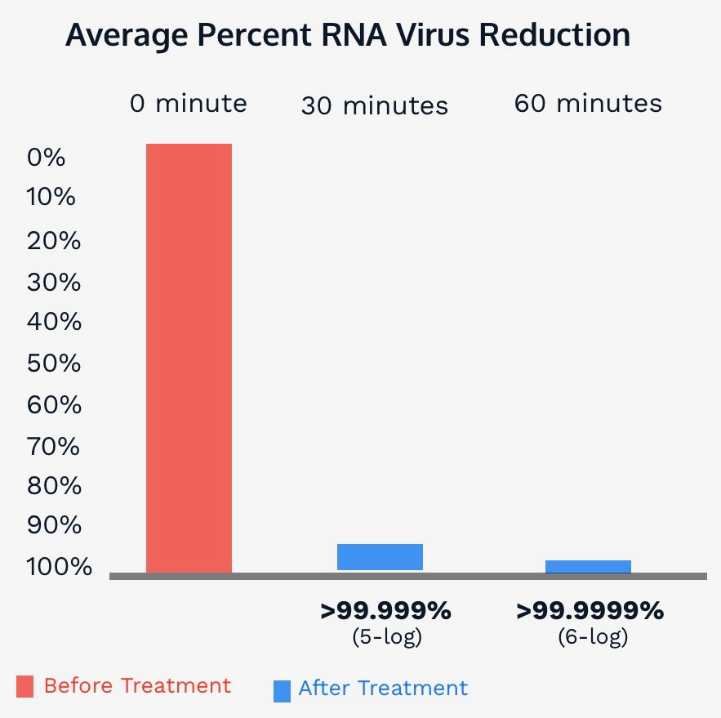
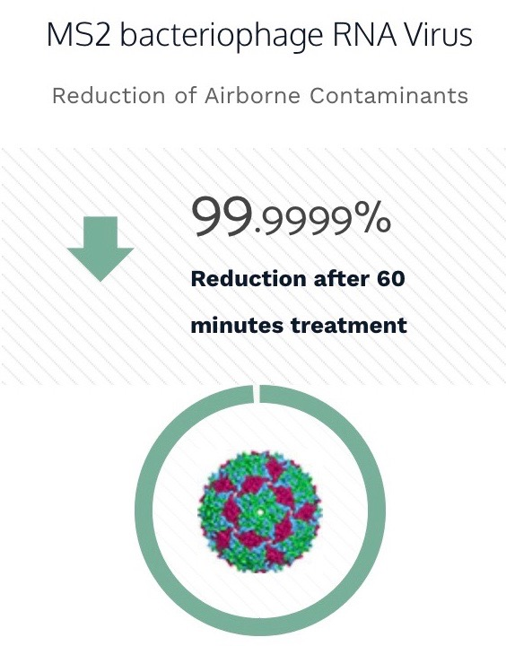
Scientific Proof
Results based on laboratory testing
Scientific data repeatedly shows that ActivePure® is the most powerful air and surface purification technology ever discovered.
NEW ACTIVEPURE MEDICAL UNIT TESTING
Complying with FDA Protocols in a FDA Certified Compliant Laboratory Net Log Reduction of MS2 Bacteriophage Virus Bioaerosol

Slide 11
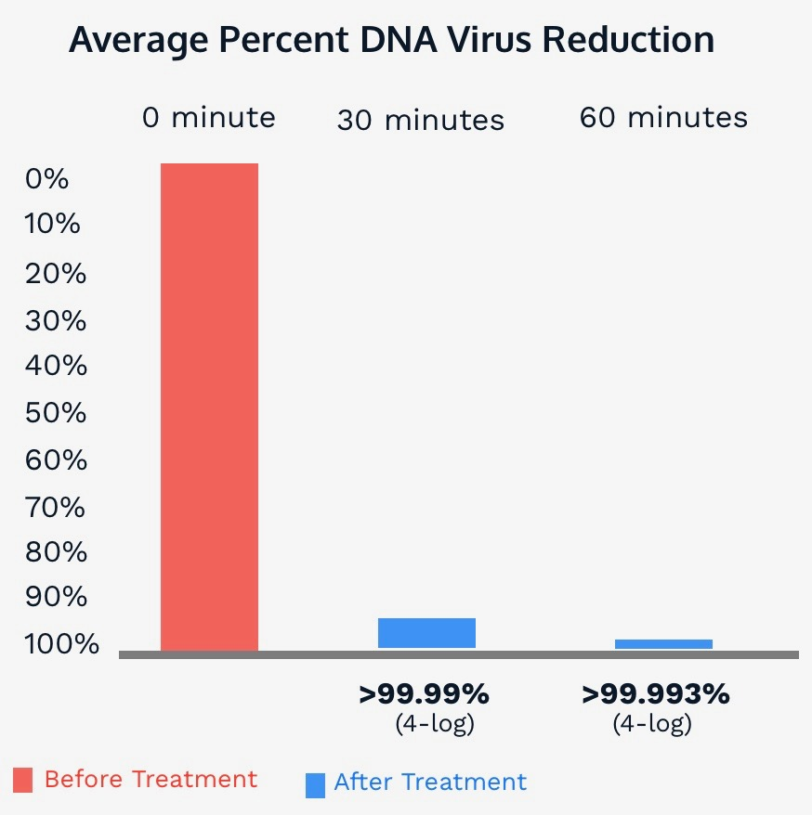
Scientific Proof
Results based on laboratory testing
Scientific data repeatedly shows that ActivePure® is the most powerful air and surface purification technology ever discovered.
NEW ACTIVEPURE MEDICAL UNIT TESTING
Complying with FDA Protocols in a FDA Certified Compliant Laboratory Net Log Reduction of MS2 Bacteriophage Virus Bioaerosol

Slide 12
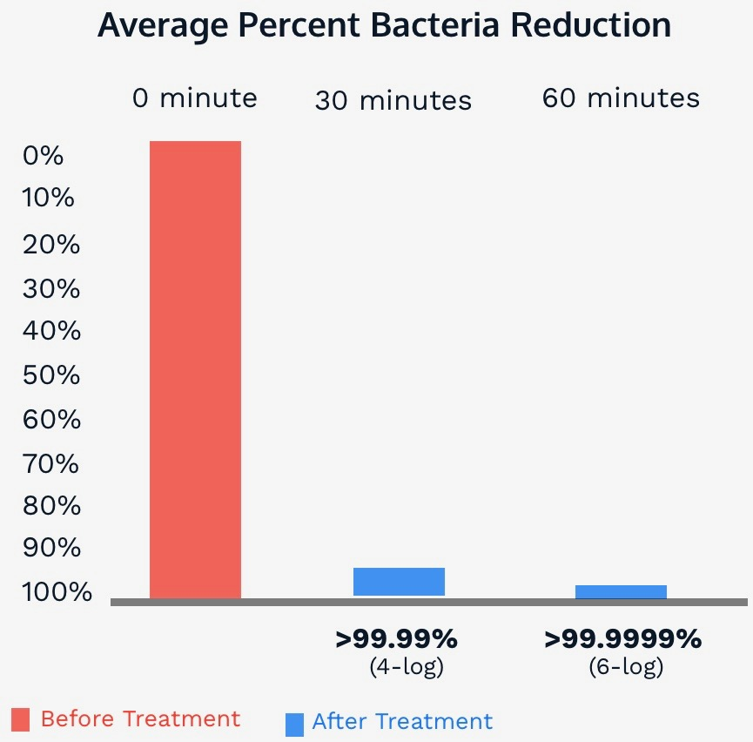
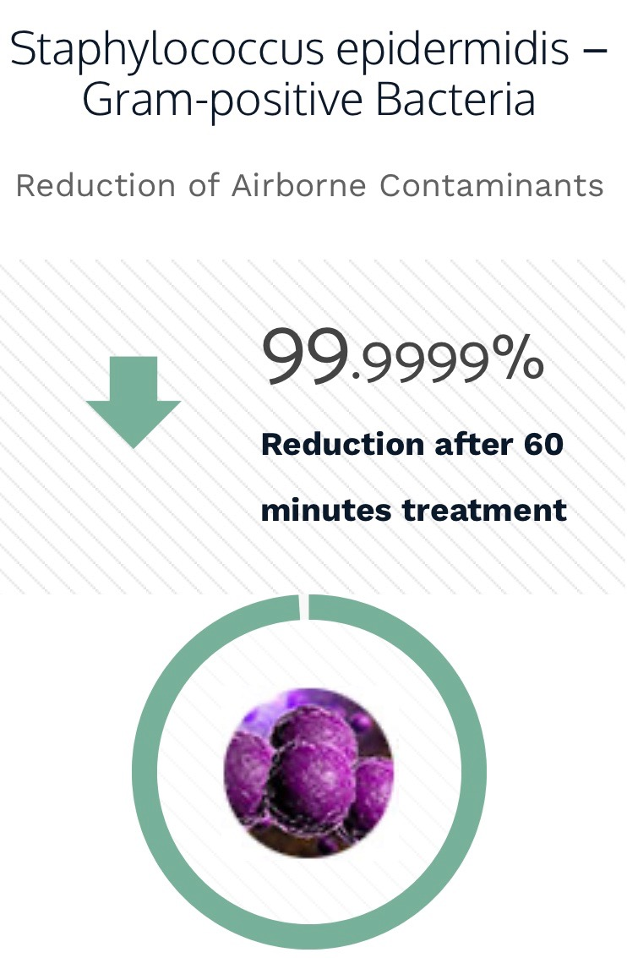
Scientific Proof
Results based on laboratory testing
Scientific data repeatedly shows that ActivePure® is the most powerful air and surface purification technology ever discovered.
NEW ACTIVEPURE MEDICAL UNIT TESTING
Complying with FDA Protocols in a FDA Certified Compliant Laboratory Net Log Reduction of MS2 Bacteriophage Virus Bioaerosol

Slide 13
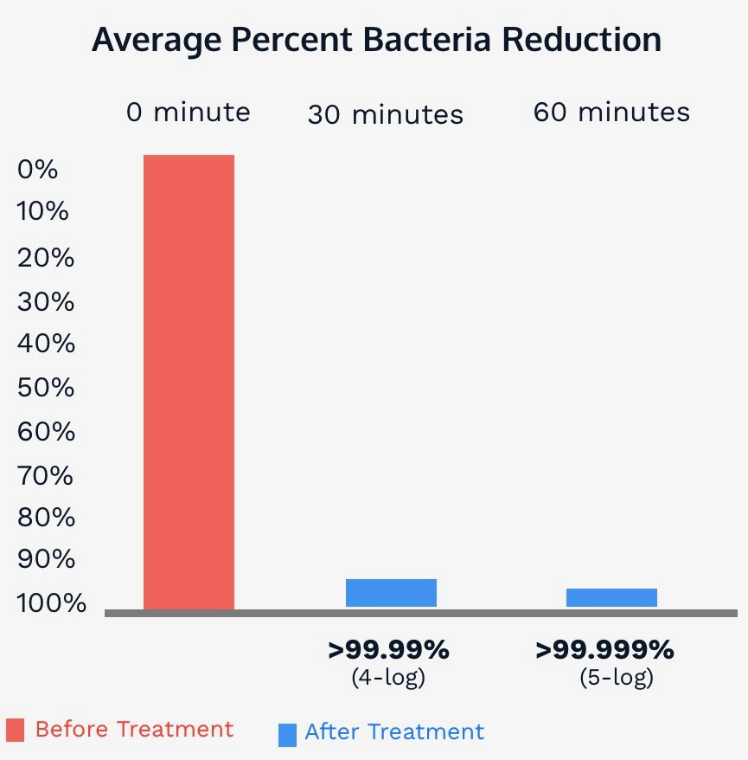
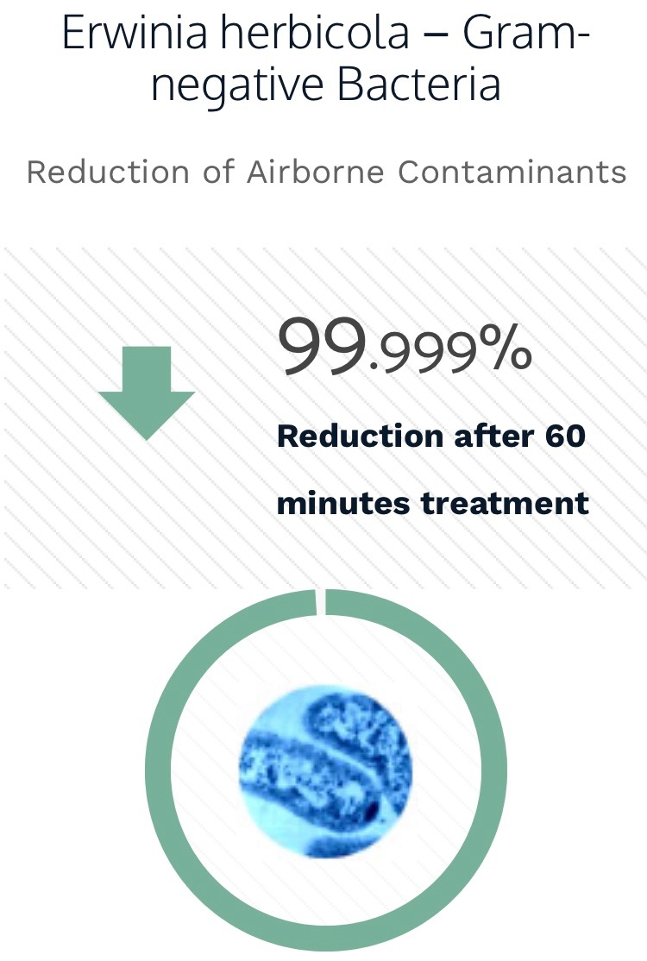
Scientific Proof
Results based on laboratory testing
Scientific data repeatedly shows that ActivePure® is the most powerful air and surface purification technology ever discovered.
NEW ACTIVEPURE MEDICAL UNIT TESTING
Complying with FDA Protocols in a FDA Certified Compliant Laboratory Net Log Reduction of MS2 Bacteriophage Virus Bioaerosol

Slide 14
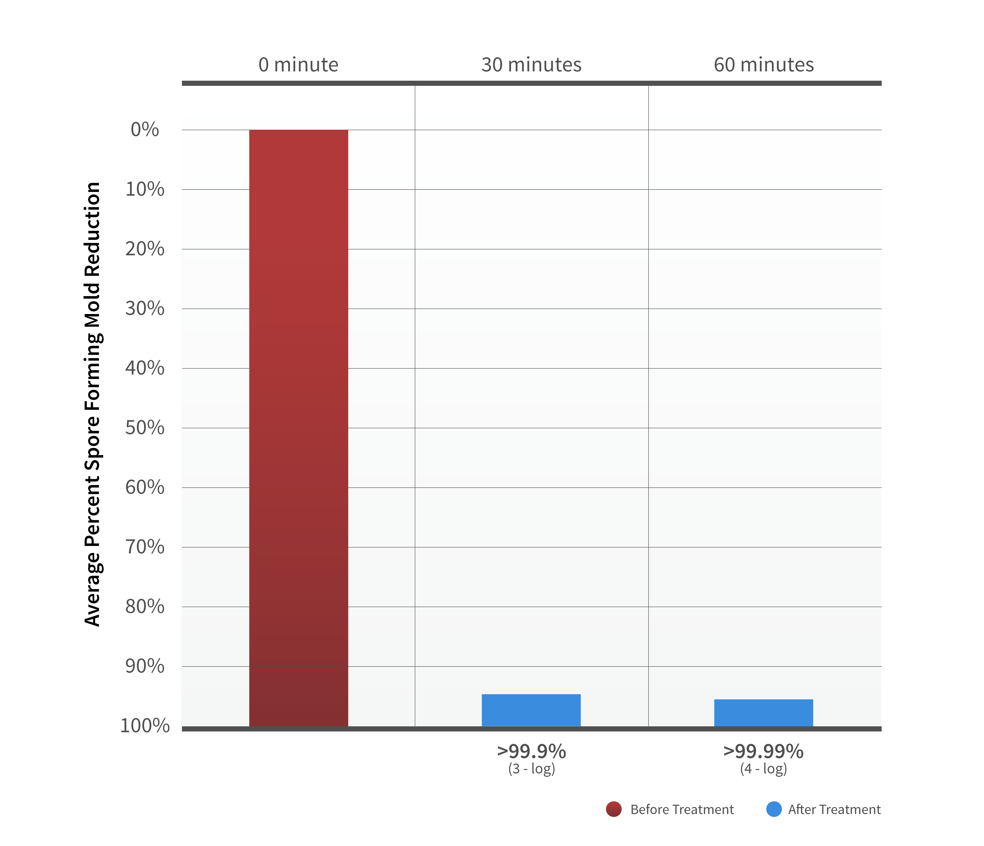
Aspergillus niger
Reduction of Airborne Contaminants
Scientific Proof
Results based on laboratory testing
Scientific data repeatedly shows that ActivePure® is the most powerful air and surface purification technology ever discovered.
NEW ACTIVEPURE MEDICAL UNIT TESTING
Complying with FDA Protocols in a FDA Certified Compliant Laboratory Net Log Reduction of MS2 Bacteriophage Virus Bioaerosol

Slide 15
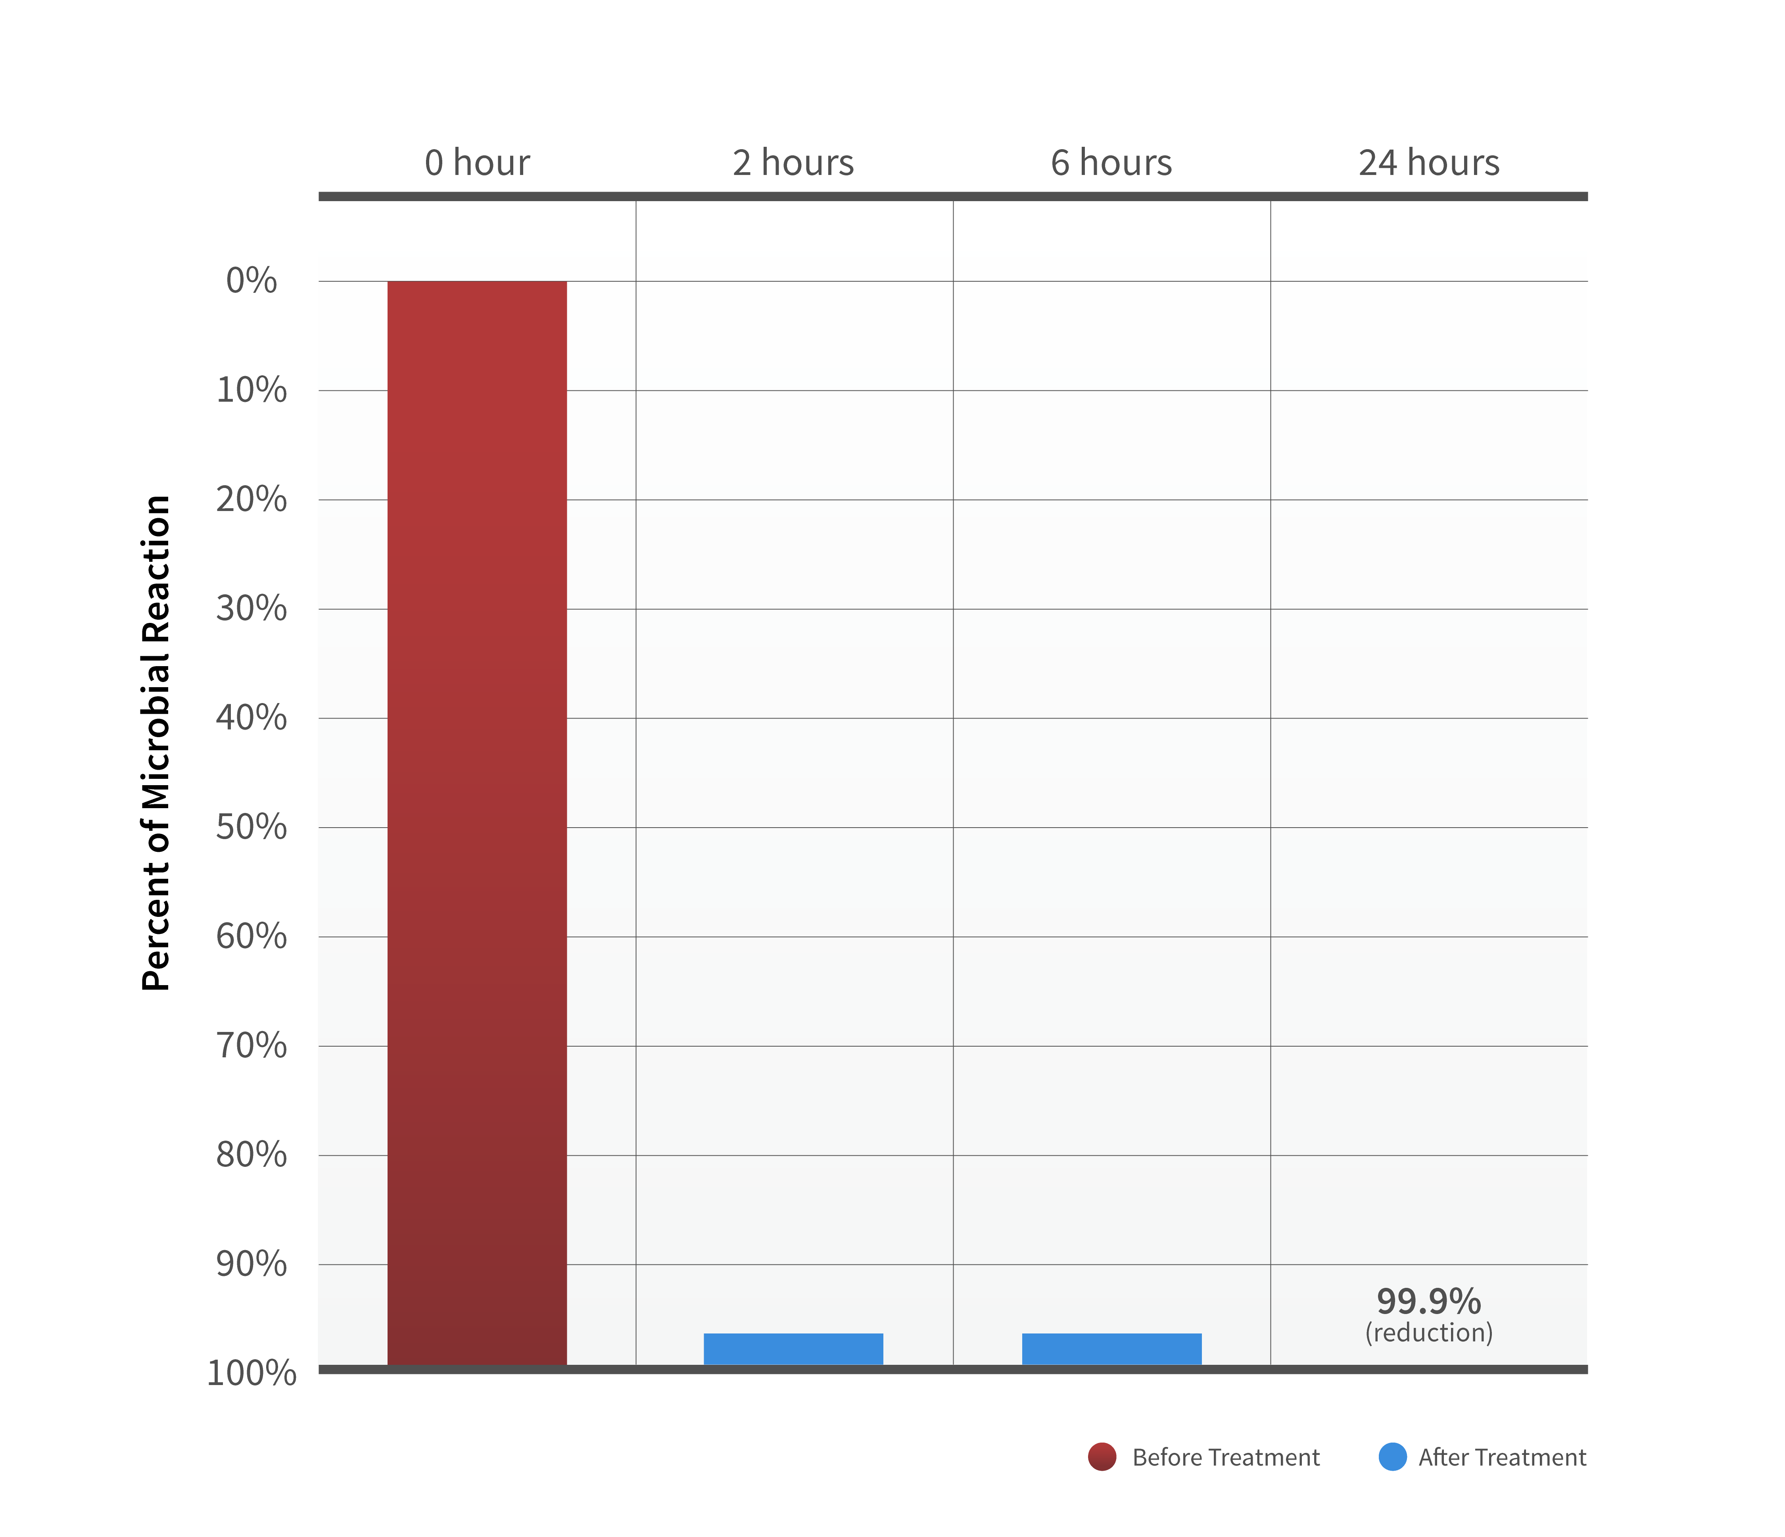
MRSA (antibiotic resistant staph) OVER 99% REDUCTION OF MICROBES IN 24 HOURS
Scientific Proof
Results based on laboratory testing
Scientific data repeatedly shows that ActivePure® is the most powerful air and surface purification technology ever discovered.
NEW ACTIVEPURE MEDICAL UNIT TESTING
Complying with FDA Protocols in a FDA Certified Compliant Laboratory Net Log Reduction of MS2 Bacteriophage Virus Bioaerosol

Slide 16
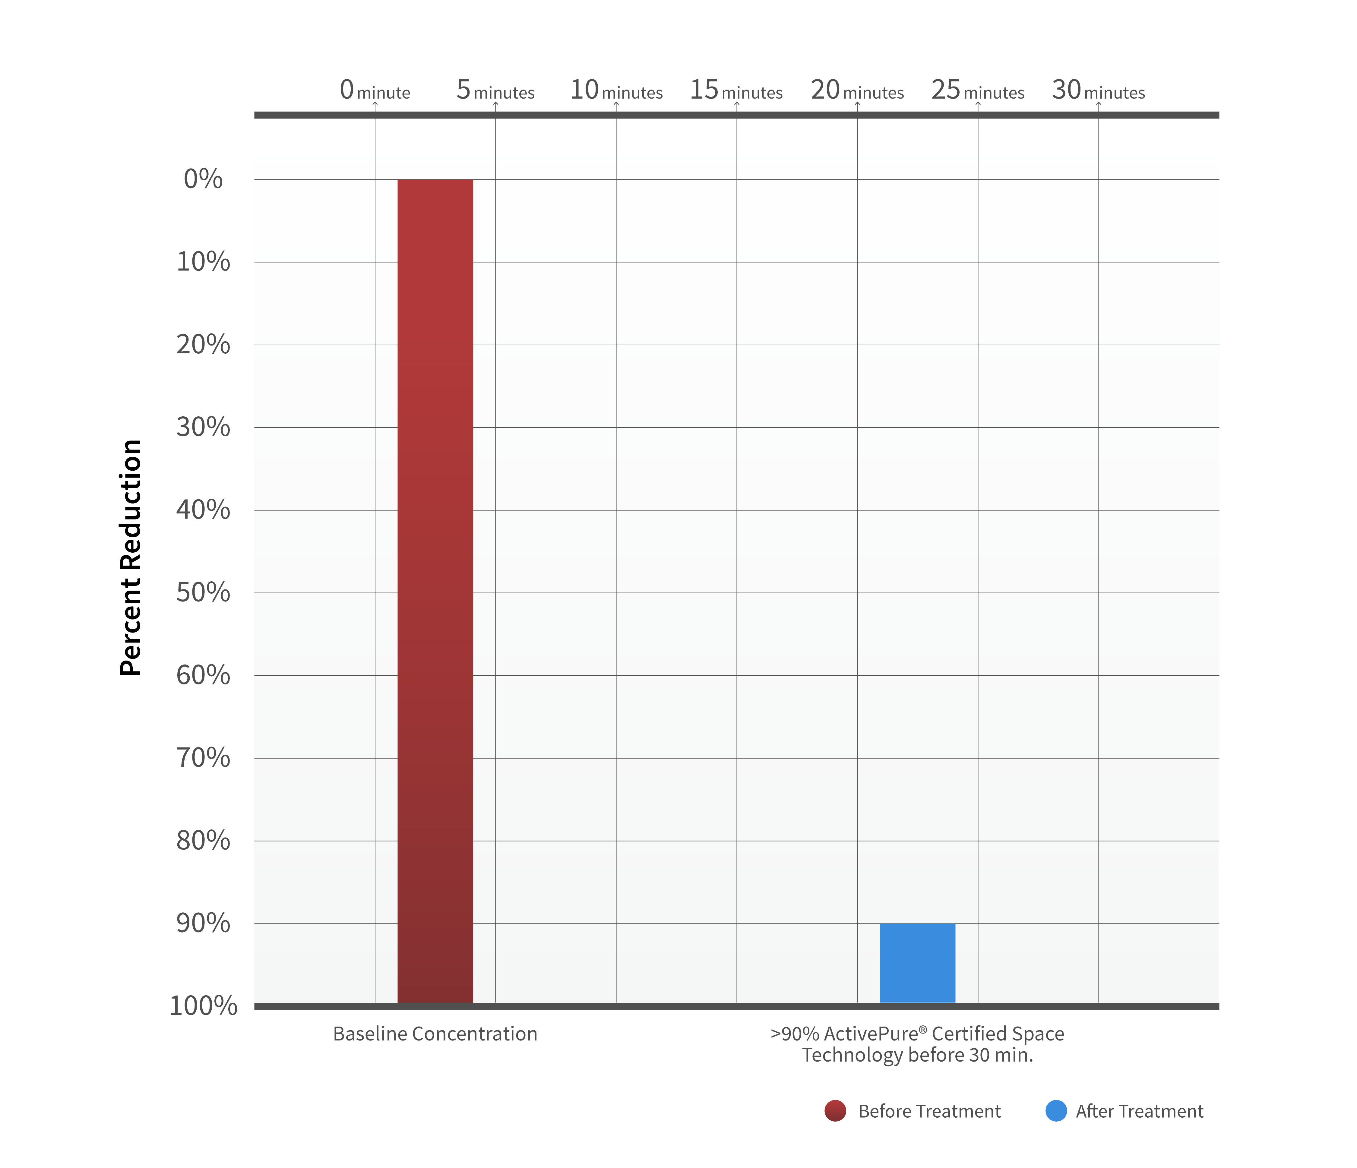
REDUCTION OF AIRBORNE CONTAMINANTS
ActivePure® Technology Testing Conducted by University of Cincinnati In only 30 minutes our technology reduces over 90% of the contaminants in the air
Scientific Proof
Results based on laboratory testing
Scientific data repeatedly shows that ActivePure® is the most powerful air and surface purification technology ever discovered.
NEW ACTIVEPURE MEDICAL UNIT TESTING
Complying with FDA Protocols in a FDA Certified Compliant Laboratory Net Log Reduction of MS2 Bacteriophage Virus Bioaerosol

Slide 17
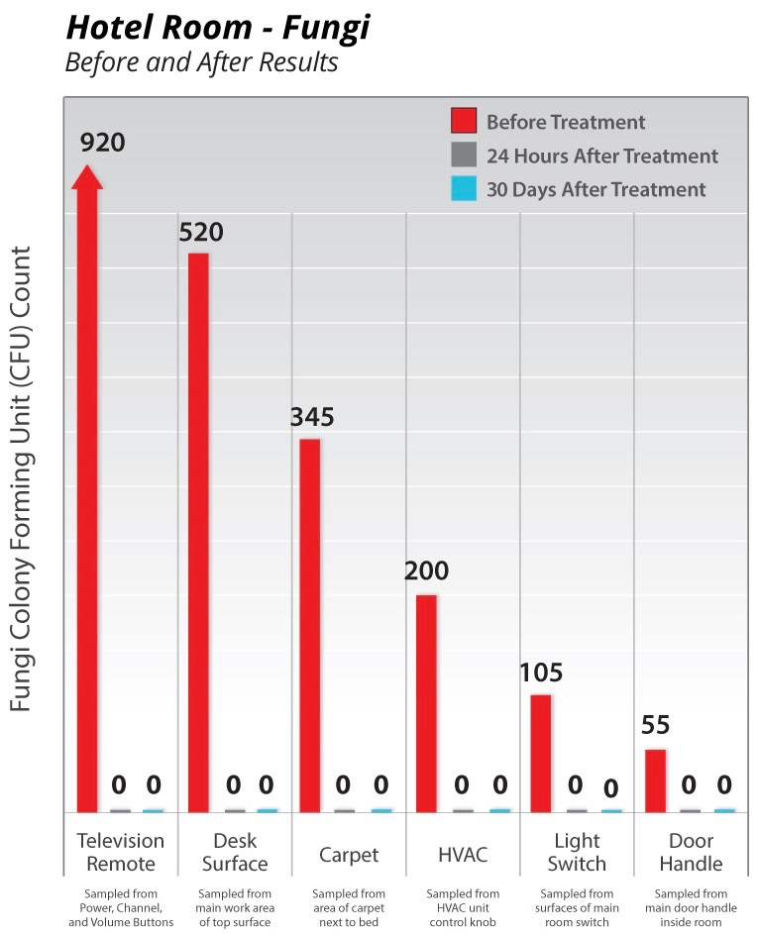
.
Scientific Proof
Proven testing results based from active living environments

Slide 18
Scientific Proof
Proven testing results based from active living environments

Slide 19
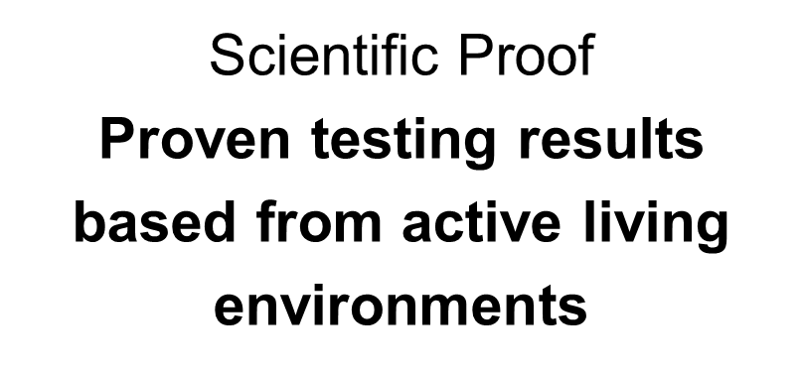

Slide 20
Earn Money Three Ways!
Retail Income Share the Products
Wholesale Build your personal team and create recurring annual income
Residual Income Share the Opportunity via Virtual Franchising

Slide 22
Retail
Market one SILVER 3-Pack Per Month (1 every 10 days)
$1,699 investment or $566 per unit $1,499 Retail/unit
Suggested Retail - $1,499 566 Your Cost
$2,799 Retail margin per 3-Pack – 160% ROI $ 933 Profit/Unit
$33,588/year
Market one GOLD 5-Pack Per Month (1 every 6 days)
$2,699 investment or $539 per unit $1,499 Retail/unit
Suggested Retail - $1,499 539 Your Cost
$4,800 Retail margin per 5-Pack – 180% ROI! $ 960 Profit/Unit
$57,600/year

Slide 23
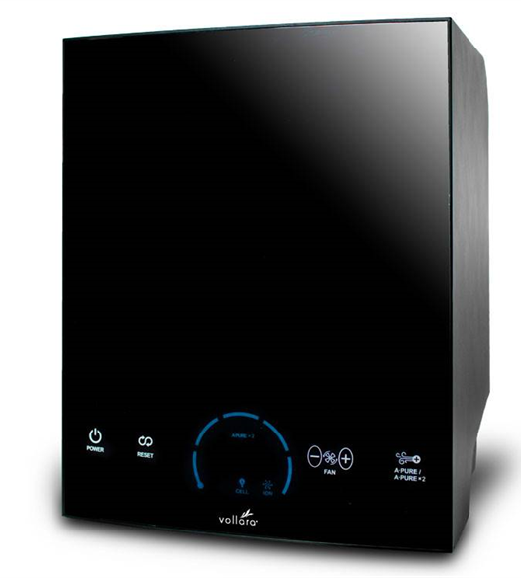
Easy Lease-Purchase Funding for Business Owners (Optional)
$500-$15,000 approvals and funding for business owners
Business owners save time and preserve their liquidity
Their CPA will tell them it’s a tax write-off for their business
You’ll close more deals – Move more products
Application is sent to business owner from computer
Customer fills out application – Takes about 2 minutes
Customer selects payment option
You GET PAID!

Slide 24
Wholesale
One unit = $1,499 Retail
SILVER 3-Pack at Wholesale = $1,699 ($566/unit – 3 units only $200 more than 1 at Retail)
GOLD 5-Pack at Wholesale = $2,699 ($539/unit – 5 units only $1,200 more than 1 at Retail)
Every time you Sponsor an Associate with a Pack:
SILVER 3-Pack:
Earn $200 Fast Start Bonus + 1,000 TQV x 20% Silver Bonus = $400
Earn $200 Fast Start Bonus + 1,000 TQV x 35% GOLD Executive Bonus = $550
GOLD 5-Pack:
Earn $200 Fast Start Bonus + 1,800 TQV x 20% Silver Bonus = $560
Earn $200 Fast Start Bonus + 1,800 TQV x 35% GOLD Executive Bonus = $830

Slide 25
Team Builder
Build a PERSONAL TEAM Generating 25,000 Team Volume
Earn up to 35% (average 20%) = $5,000/mo. = $60,000/year
Earn $600 Bonus Car Reward/mo. = 7,200/year
Earn Travel 10,000/year
Earn $1,000 Executive Bonus Boost/mo. = 12,000/year
Earn Fast Start Bonuses = ?
$100,000+/year

Slide 26
Team Builder
Build an EXECUTIVE TEAM Generating 15,000 to 25,000 Team Volume
Help 3 become GOLD Executives at 25,000 Team Volume
Earn 15% x 25,000 x 3 = $11,250/month
Help 3 help 5 become GOLD Executives at 15,000 Team Volume
Earn 4% x 15,000 x 5 = $3,000/month
Help 5 help 10 become GOLD Executives at 15,000 Team Volume
Earn 3% x 15,000 x 10 = $4,500/month
$18,750/month - or - $225,000/year
Executive Bonuses Paid to 5 levels
PLUS: Your Personal Team + Car Bonus + Travel + Fast Start Bonuses

Slide 27
Getting Started Checklist for High Achievers
Go to your Sponsor’s website and JOIN NOW for FREE
Order an Air & Surface Pro Pack:
GOLD 5-Pack (Best Value)
or SILVER 3-Pack
Your story – how you got started…
People tend to do what you do.
Pay by credit card – or – Vollara EZ Pay (90 days - NO CREDIT CHECK)
Set a Goal to achieve GOLD Executive within your 3-month Fast Start Period
or any one month during your Fast Start Period
ONE TEAM ONE DREAM

