Slide 1
Welcome to Vollara

Slide 2
Stable, Secure, Strong, Supportive
Aerus Holdings: Parent company with over $300M in annual portfolio sales and roots in an 85-year-old direct selling business
Part of a family of companies recognized as 39th largest direct selling company in the world
Aerus Holdings has been ranked in the Top 100 privately held companies in Dallas-Fort worth (Dallas Morning News)
Corporate World Headquarters
Dallas, Texas
Manufacturing Facility
Bristol, Virginia

Slide 3
Have you heard about our proprietary ActivePure® Technology, the only exclusive air and surface purification technology recognized exclusively, worldwide as NASA Certified Space Technology by the Space Foundation?

Slide 4
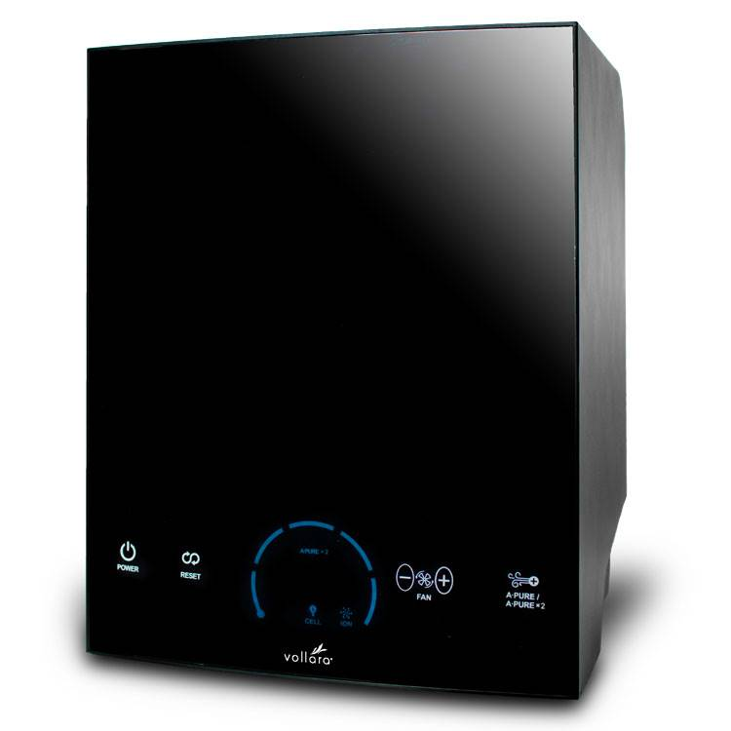
Air & Surface Pro
This small but powerful air purifier uses ActivePure Technology to eliminate smoke, odors, and other contaminants in the air
Coverage up to 500 sq. ft. to 3,000 sq. ft. (42 m² to 278 m²)
Eliminates common triggers of allergies, asthma, and irritants to those with sensitive immune systems
Portable, no installation required
Destroys VOCs, smoke and odors without ozone
ActivePure® is the only air purification technology recognized exclusively, worldwide, as Certified Space Technology
3-year limited warranty
Unique Features
Positive and Negative Multipoint and RF Ion Generation
Five-speed fan
LCD display
Maintenance reminders
Replaceable ActivePure® Cells
Removable rear grill
Universal Power supply with cords
HEPA + Activated Carbon Filters
How It Works
Uses ActivePure® Technology to create pristine air quality and attack contaminants on surfaces
Provides ozone-free air and surface cleaning

Slide 5
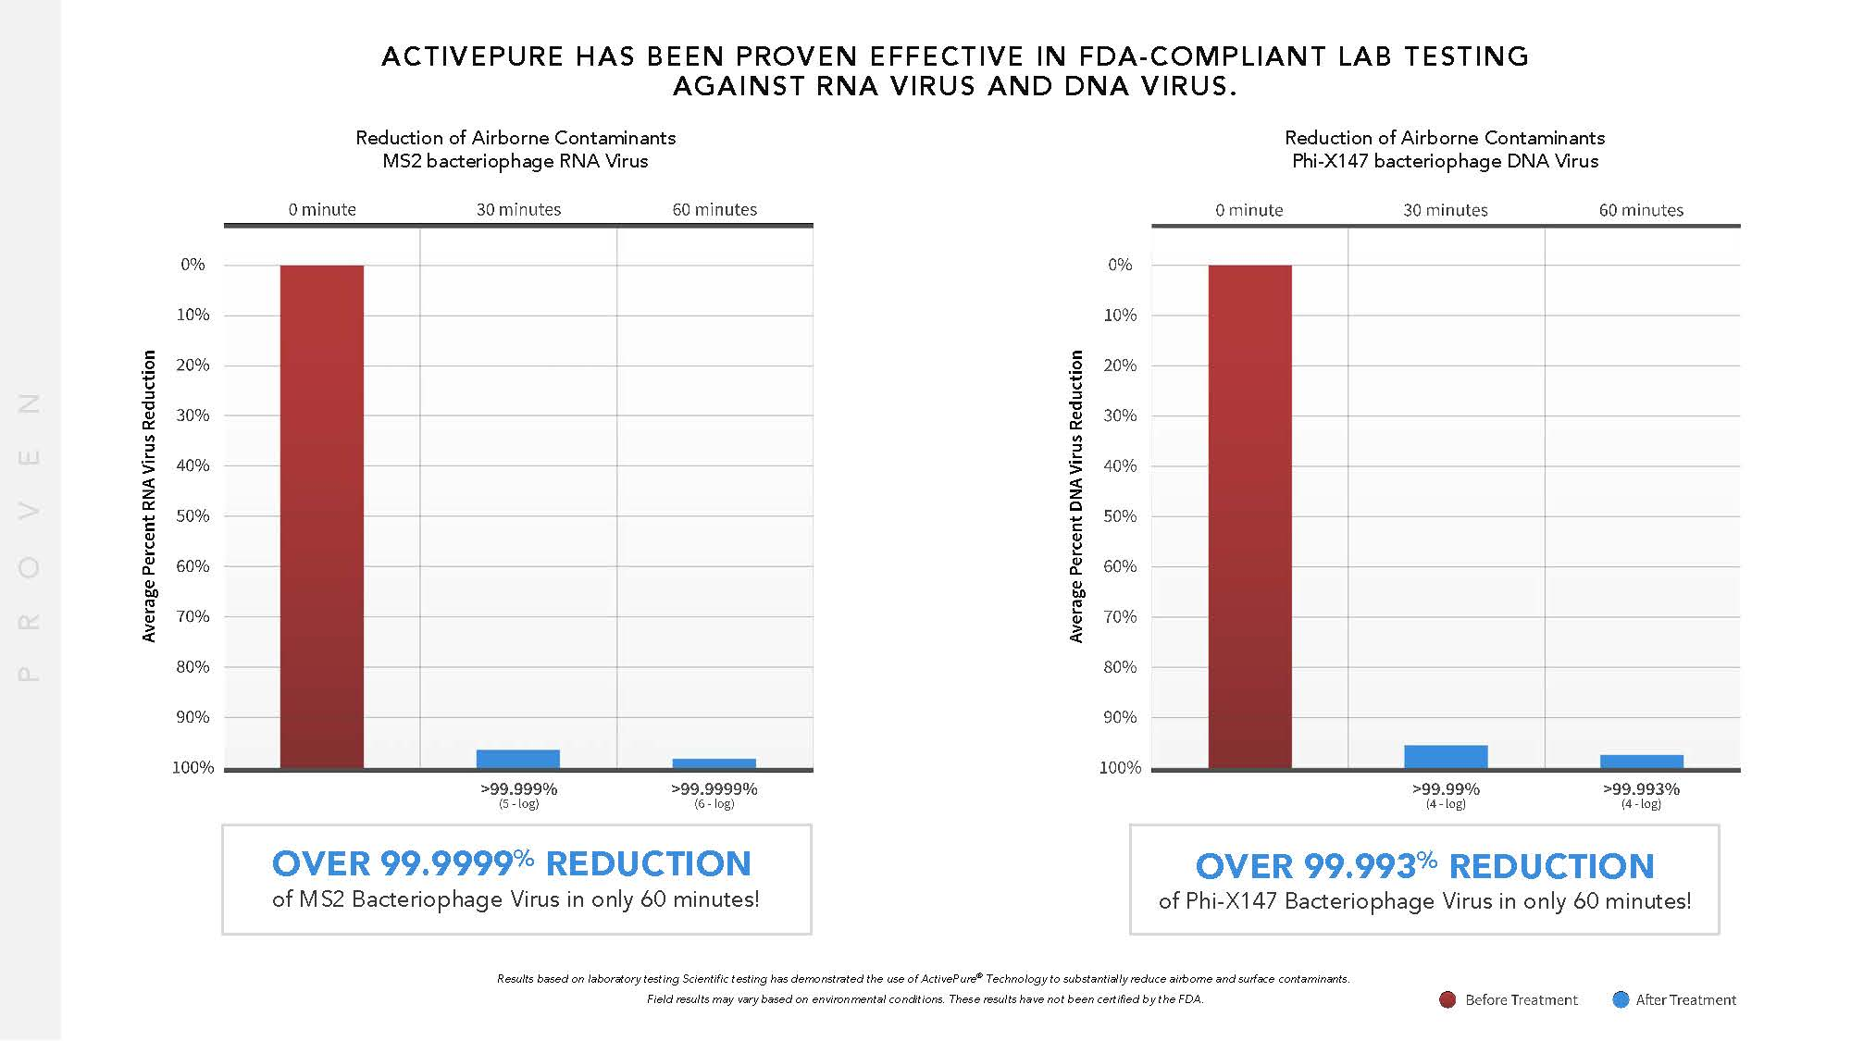

Slide 6
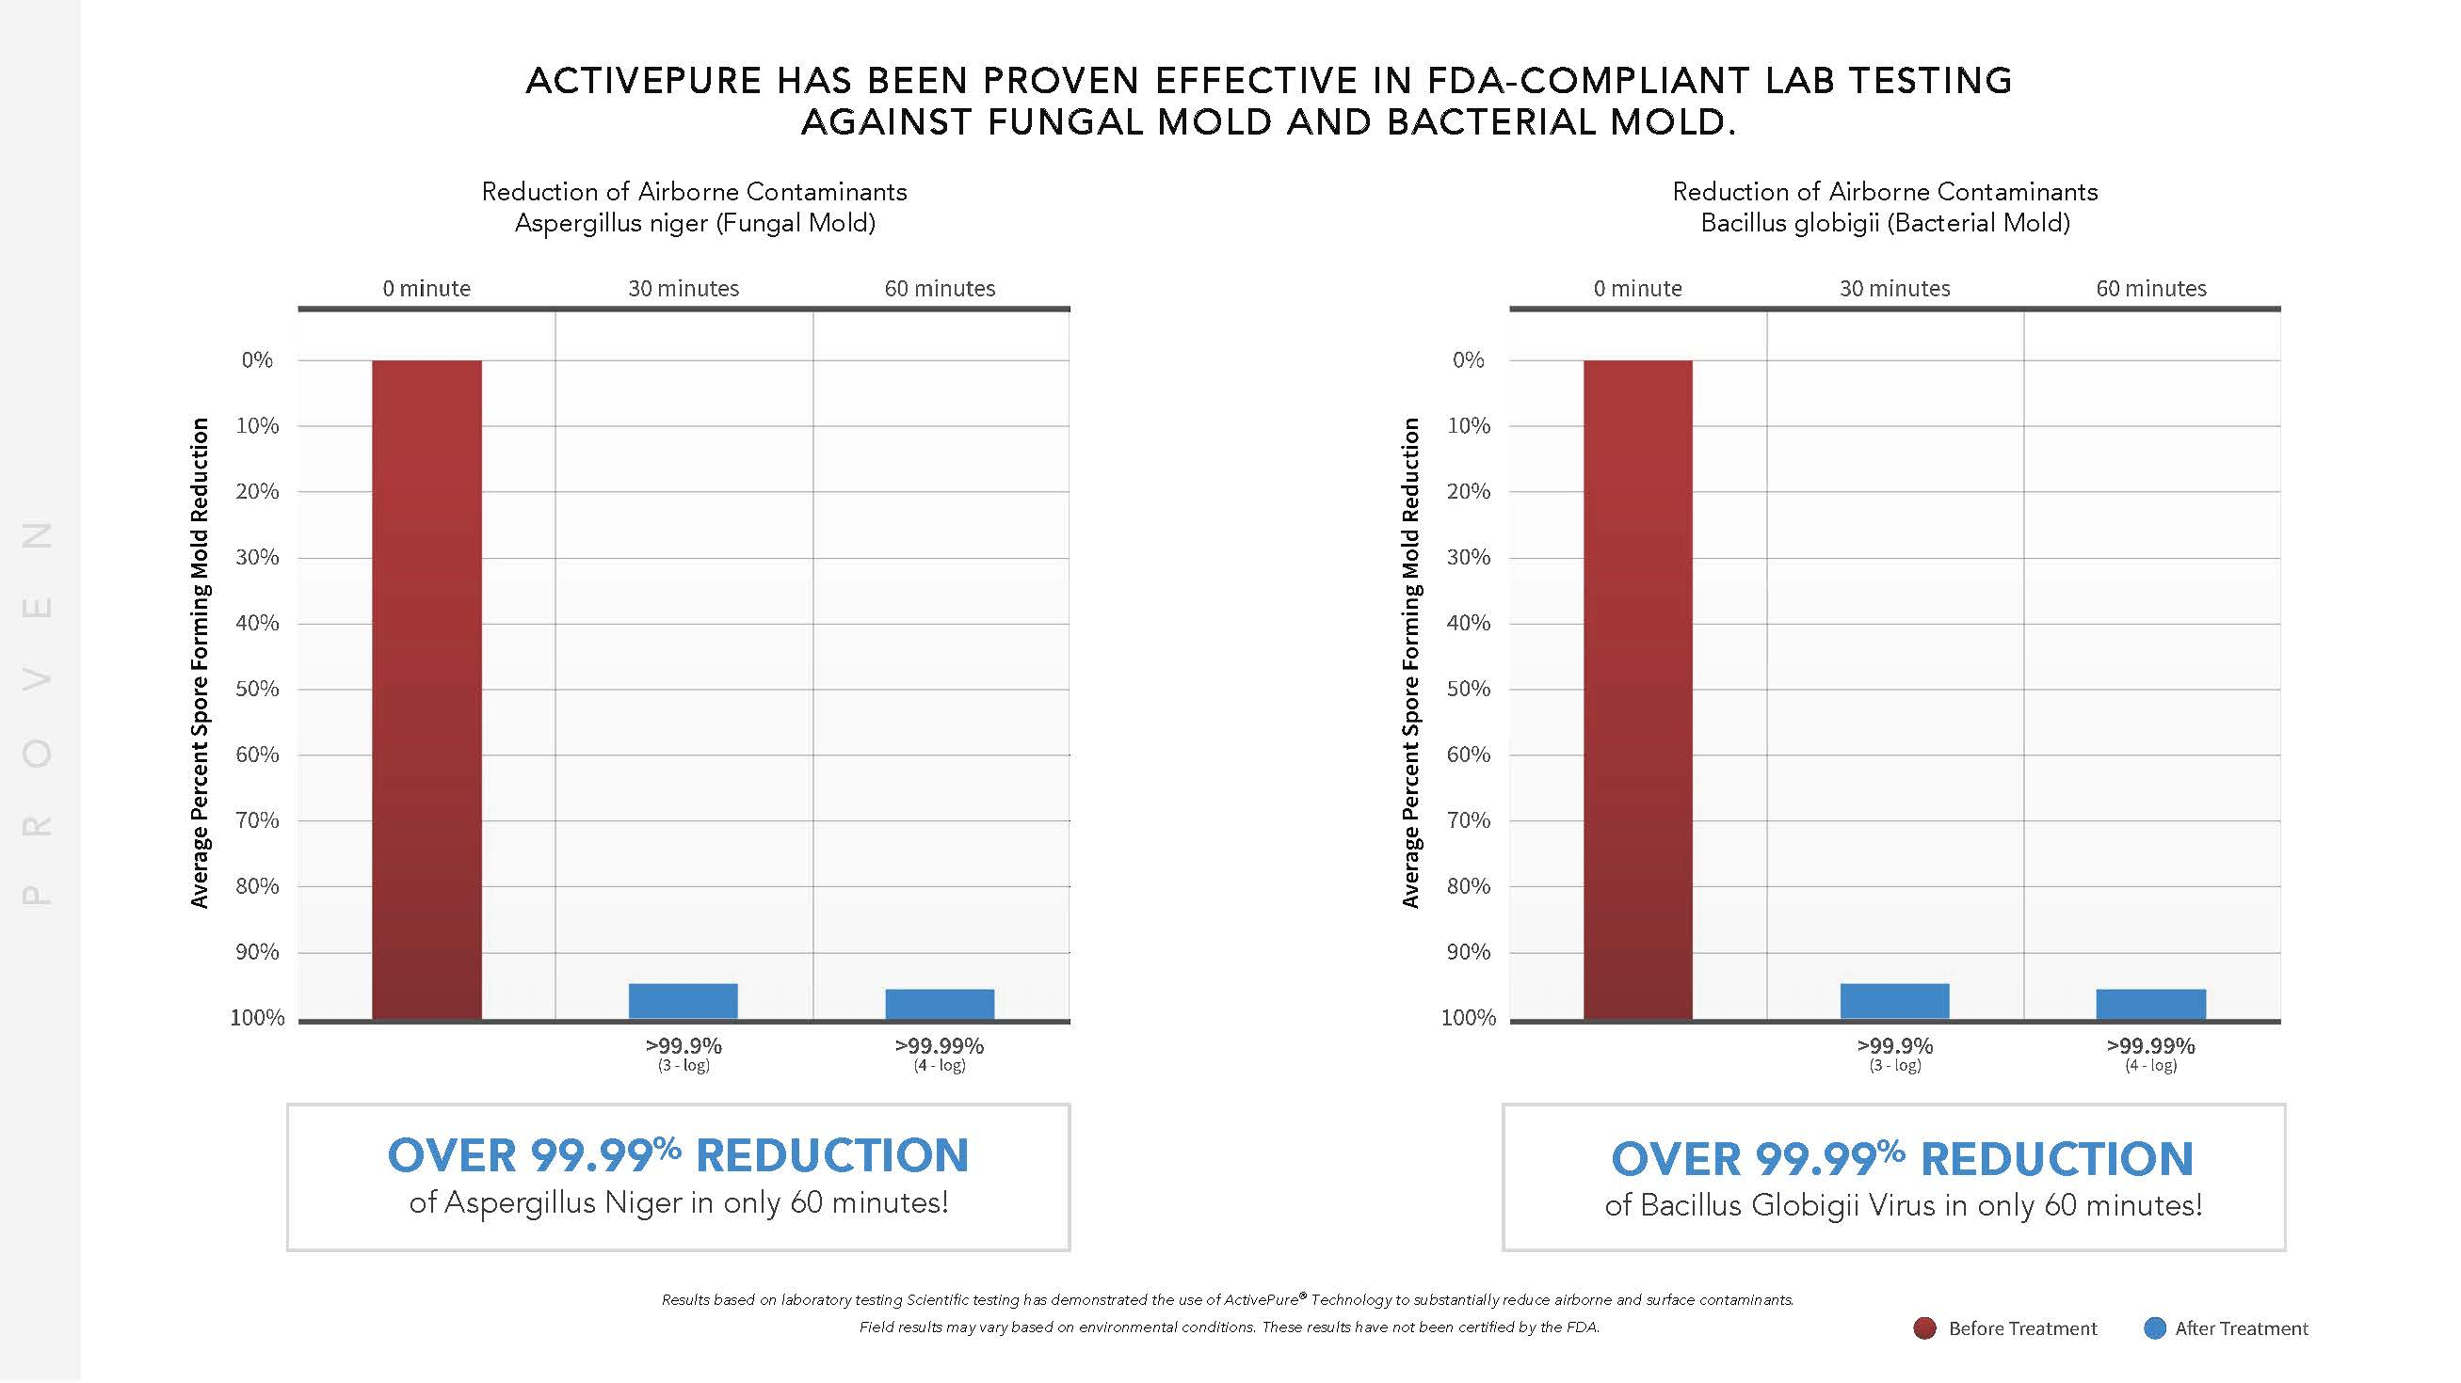

Slide 7
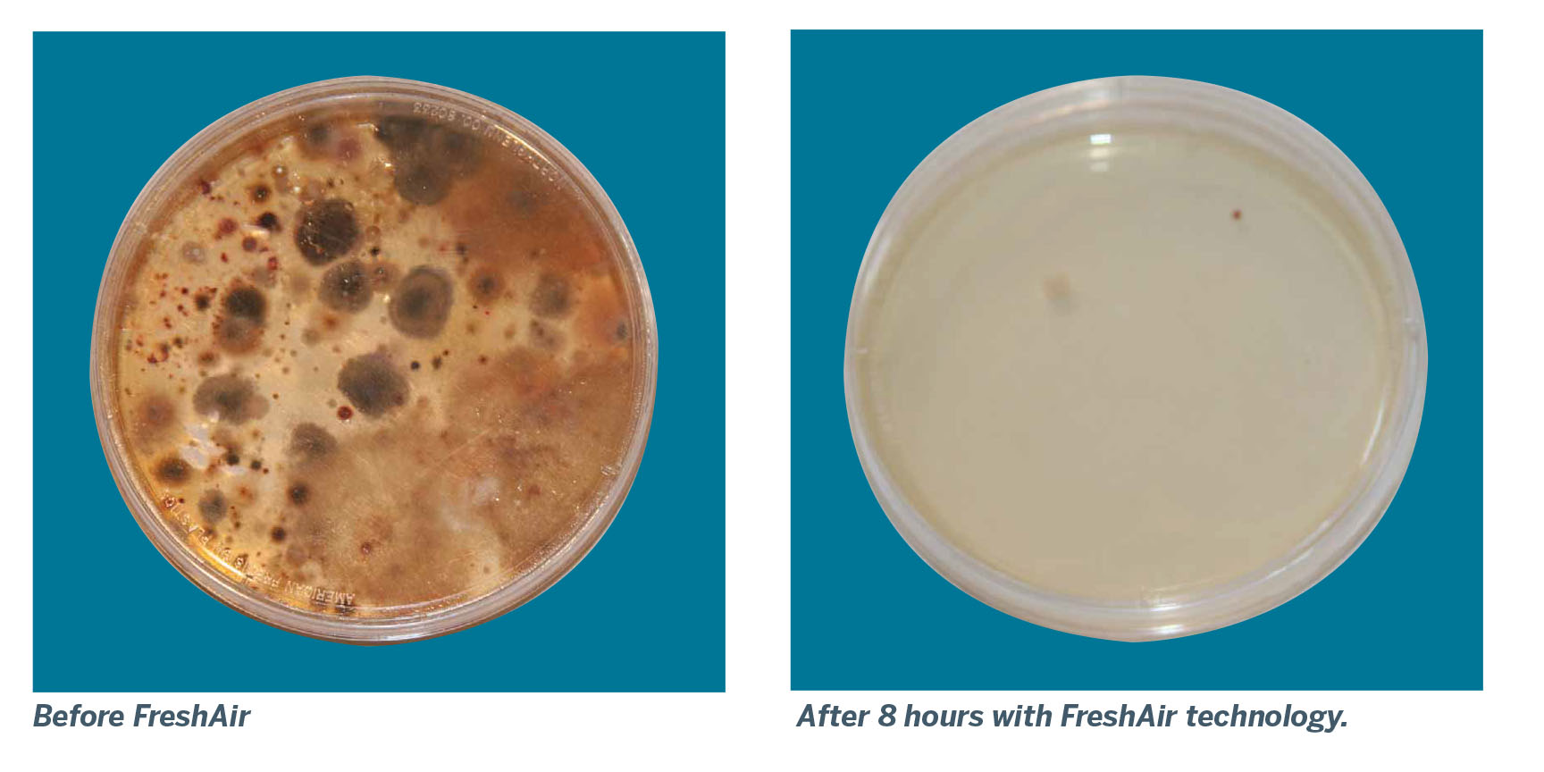
Do You Know What You’re Breathing?
Ensure a Breath of Fresh Air with Vollara!
Before and after laboratory tests showing reductions of airborne contaminants with the FreshAir Surround.
Based on preliminary test results. Field results may vary. Results do not constitute scientific substantiation.

Slide 8
Space Technology Hall of Fame

Slide 9
Defense Department Tokens of Appreciation for ActivePure® (RCI) Technology

Slide 11
Certified for Continuous Air & Surface Sanitization

Slide 13
Why Start Your Own Business?
I want to feel more secure.
I want to be my own boss!
I want to get out of debt.
I hate my job!
I want more control over my time!
I want to feel good about me!
I lost my job!
Tax Savings
If others can do it, why not me?!
Which Is Your Primary Reason?

Slide 14
If You Were Going To Start A Business...
What Kind of Business Would Be Best?

Slide 15
Criteria For Selecting a Viable, Legitimate Business
Must be unique - not a “me too” product
Must solve a common problem – the bigger the market the better
Must solve this problem relatively quickly
Must solve this problem easily without much effort and
Must offer more value than the customer pays for.

Slide 16
Bet On The Jockey!
You can increase your odds of success by finding a person or company that has succeeded before and uses proven duplicable systems.
“Bet on the jockey, not the horse…”
- Warren Buffet

Slide 17
Is One Business Category Better Than Another?
According to the Prestigious Battelle Scientific Report On The Top 10 Trends for a Healthy Home for 2018 and beyond, www.battelle.org
• Trend #1 – Indoor Air Quality
• Trend #4 – Reliable, Clean Electricity
• Trend #5 – Pure Water
• Trend #8 – Management of Dust Mites
• Trend #10 – Germ Protection on Surfaces
Vollara responds well to these and other health and business trends!

Slide 18
Earn Money Three Ways!
Retail Income From Sharing the Products
Wholesale Build your personal team and create recurring annual income
Residual Income From Sharing the Opportunity via Virtual Franchising

Slide 19
RETAIL
Market one 5-pack per month
$2,699.00 investment or $538 per unit
Suggested Retail $1499
$4,805 retail margin per 5 pack – 180% ROI!
$57,660 annual
Friends a family pricing $1,200
$3,310 retail margin per 5 pack – 125% ROI!
$39,730 annual

Slide 20
RETAIL
Market one 3-pack per month
$1,699.00 investment or $566 per unit
Suggested Retail $1499
$2,799 retail margin per 3 pack – 160% ROI
$33,588 annual
Friends a family pricing $1,200
$1,902 margin per 3 pack – 120% ROI
$22,824 annual

Slide 21
WHOLESALE Earn great income helping your team earn great income
$ in your eyes for your team
Promote to 20% Fast Start Bonus when you sponsor 1 with a pack
Promote to Silver Executive 20%
Promote to Gold Executive 35%
Earn $560.00 every time you sponsor an associate with a 5 pack at 20%
Earn $830.00 every time you sponsor an associate with a 5 pack at 35%

Slide 22
WHOLESALE Earn great income helping your team earn great income
$ in your eyes for your team
Build a personal team generating 25,000 Team Volume
Earn up to 35% (average 20%) = $5000
Earn $600 Bonus Car award
Earn $1000 Executive Bonus Boost
Plus Fast Start, Sponsor Bonuses = $90,000 Compensation Package

Slide 23
TEAM BUILDER John Rockefeller: I would rather earn 1% off a hundred people’s efforts than 100% of my own efforts.
Help 3 others become Gold Executives at 25,000 Team Volume
Earn 15% monthly = $11,250
Help your 3 help 5 become Gold Executives at 15,000 Team Volume
Earn 4% monthly = $3,000
Help your 5 help 10 become Gold Executives at 15,000 Team Volume
Earn 3% = $4,500

Slide 24
TEAM BUILDER John Rockefeller: I would rather earn 1% off a hundred people’s efforts than 100% of my own efforts.
This example generates $18,750.00 monthly
or $225,000 annualized
Vollara pays Executive Royalties down to 5 levels Plus your personal team + Bonus Car + Fast Start Bonuses

Slide 25
Consider the potential Lifestyle rewards when you hit the timing just right
New Revolutions changed the world we live in and lives of those that brought them to us
Henry Ford – The automobile
Bill Gates – The Computer
Mark Zuckerberg – Social Media
Healthy Spaces | Clean Air | Sanitized Surfaces | Suds Free Revolution

Slide 26
Paralysis of Analysis!
The # 1 Reason Most People Never Succeed!
“High achievers spot rich opportunities swiftly, make big decisions quickly and move into action immediately.”
- Robert Schueller

Slide 27
You can do this.
Take the first step!
Your timing couldn’t be more perfect and everything is in place. We will help you every step of the way!
If others can do it, why not you and why not now!
Take action now, vote for yourself and get started today!

